Slide 1

ECE 190 Engineering Profession and Practice
William Bishop and Scott Chen
Fall 2017
NOTE:
Students enrolled in ECE 190 may download and print these slides for their personal use in this course. Students may not redistribute the slides or post them to websites.

Slide 2
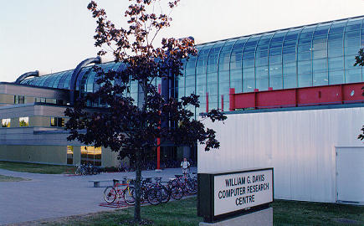
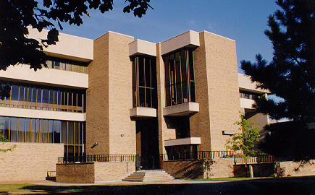
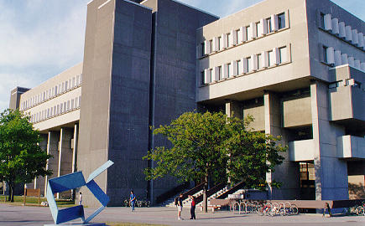
Welcome
Welcome to Electrical and Computer Engineering at the University of Waterloo!
William G. Davis Computer Research Centre
Carl A. Pollock Hall
Mathematics and Computer Building

Slide 3
Lecture 1
Course Introduction / Using LEARN

Slide 4
Lecture Outline
This lecture will examine the following topics:
Overview of the course
Course grading scheme
Review of applicable university policies
Using the course management system (LEARN) effectively

Slide 5
Course Description
In this course, you will explore the engineering profession:
You will learn about tools and techniques used by professionals practicing the discipline of electrical and computer engineering
You will be exposed to concepts from other engineering disciplines
You will be taught the engineering design process and the role of the engineer in protecting public safety
You will learn about business and entrepreneurship in the context of electrical and computer engineering
Through the seminar series on Co-operative Fundamentals for Engineering, you will develop skills necessary for career development and co-op employment
Notes:
Highest number of entrepreunrs from Uwaterloo.
Accelerometer: Civil engineering into computer engineering
WIMMIS; Dont put capacitors the other way

Slide 6
Calendar Description
“Introduction to Electrical and Computer Engineering with an emphasis on the profession of engineering and engineering design. Topics include: engineering design, safety, risk analysis, engineering data analysis, project management, sustainability, business, entrepreneurship, and intellectual property. Additional topics include co-op fundamentals for engineering students, professional development, and diversity training.”
Prereq: Level at least 1A Computer Engineering or Electrical Engineering
Antireq: ECE 100A

Slide 7
Class Schedule
Class | Class Section | Instructor | Class Day | Class Time | Class Room
8046 | LEC 001 | William Bishop | Tuesday Thursday | 4:00 pm to 4:50 pm 4:00 pm to 4:50 pm | STC 0060 STC 0060
8047 | LEC 002 | Wei-Ting (Scott) Chen | Tuesday Thursday | 4:00 pm to 4:50 pm 4:00 pm to 4:50 pm | RCH 301 RCH 301
8048 | LEC 003 | Wei-Ting (Scott) Chen | Tuesday Thursday | 1:30 pm to 2:20 pm 1:30 pm to 2:20 pm | RCH 302 RCH 302
NOTE:
Classes start: Thursday, September 8th.
Thanksgiving holiday (no lectures): Monday, October 10th.
Study days (no lectures): Tuesday, October 11th and Wednesday, October 12th.
Makeup day: Thursday, October 13th replaces the Tuesday, October 11th study day.
Makeup day: Friday, October 14th replaces the Wednesday, October 12th study day.
Midterm week (no lectures): Monday, October 17th to Friday, October 21st.
Classes end: Monday, December 5th.

Slide 8
Course Instructor
Instructor | Office Location | Campus Extension | E-mail Address | Office Hours
William Bishop | EIT 4101 | Ext. 37159 | wdbishop@uwaterloo.ca | Mondays 10:00 am to 11:00 am
Wei-Ting (Scott) Chen | EIT 4006 | Ext. 33974 | w25chen@uwaterloo.ca | Thursdays 10:00 am to 11:00 am
NOTE:
Students may visit an instructor to inquire about any aspect of the course. Questions regarding course topics, course materials, deadlines, and grading should be directed to the instructor. Each instructor has set aside an hour each week for meeting with students. An appointment is not needed to meet with the instructor during regularly scheduled office hours. If for any reason, a meeting outside of regularly scheduled office hours is required, an individual appointment with an instructor may be booked by contacting your instructor via e-mail or via phone. The phone number for the main campus of the university is (519) 888-4567.
Notes:
Scott Chen: w25chen@uwaterloo.ca EIT 4006
Is going to start a company RF
High performance biomedical sensing, high frequency scanning
ECE 150, ECE155 also did
Call me Scott not professor
Bill Bishop
First year advisor
WEEF TA’s

Slide 9
Engineering Instructional Support Tutors
Engineering Instructional Support Tutor | Office Location | Campus Extension | E-mail Address
David Lau | E2 1318A | Ext. 33888 | d24lau@uwaterloo.ca
Fiona Yiu | E2 1318B | Ext. 33802 | fyyiu@uwaterloo.ca
NOTE:
Students may visit with an engineering instructional support tutor to discuss concerns about the conduct of teaching assistants or to discuss concerns about the conduct of fellow students. Appointments with an engineering instructional support tutor may be booked by contacting a tutor via e-mail or via phone. The phone number for the main campus of the university is (519) 888-4567.
Notes:
Can be approached for any first year course

Slide 10
Teaching Assistants
Teaching Assistant | Office Location | Campus Extension | E-mail Address
Matt Belisle | E2 1303B | Ext. 35145 | mjbelisl@uwaterloo.ca
Timea Ratiu | E2 1303B | Ext. 35145 | tratiu@uwaterloo.ca
Ryan Samlalsingh | E2 1303B | Ext. 35145 | rsamlals@uwaterloo.ca
Stephen Sheng | E2 1303B | Ext. 35145 | z4sheng@uwaterloo.ca
Zizhou Wang | E2 1303B | Ext. 35145 | z628wang@uwaterloo.ca
Yijie Yuan | E2 1303B | Ext. 35145 | y235yuan@uwaterloo.ca
NOTE:
Students may visit the teaching assistants to discuss course materials, assignments, and questions on course content. An individual appointment with a teaching assistant may be booked by contacting a teaching assistant via e-mail.

Slide 11
Course Objectives
In this course, you will have an opportunity to achieve the following goals:
Prepare for entering the profession of electrical and computer engineering,
Learn about the cooperative education system at the University of Waterloo,
Understand the structure of the electrical and computer engineering program,
Develop a proficiency with engineering tools and techniques, and
Gain experience working as part of an engineering design team.
Notes:
Engineering design week: this semester or next in teams of 4 or 6 participating in 6 consecutive design week
Apply engineering knowledge ther. ECE 190 helps in there direction. Get better team dynamics and get to know the classmates. Assemble your team team dynamically.

Slide 12
Course Textbook and Seminar Slides
The required course textbook for ECE 190 is the following:
G. C. Andrews, J. D. Aplevich, C. MacGregor, and R. A. Fraser, Introduction to Professional Engineering in Canada, 4th Edition, Pearson Education Canada, April 30, 2014.
The lecture slides for this course are provided on LEARN:
W. Bishop and S. Chen, “ECE 190: Engineering Profession and Practice”, Lecture Slides, University of Waterloo, September 2017.
NOTE:
The lecture slides provide reasonably complete coverage of the essential course material but reading the textbook is strongly recommended when preparing for the quiz questions in this course.
Notes:
Buy the textbook. The professional engineering exam is after 3 years of graduating and this book has all that info. You will become a certified engineer in all of canada. More important after you graduate

Slide 13
Required Textbook Readings
Completion Date | Chapter | Pages
September 11th | Chapter 5: Learning Strategies | p. 67 – p. 76
September 18th | Chapter 1: An Introduction to Engineering Chapter 2: The Licensed Professional Engineer | p. 3 – p. 15 p. 19 – p. 33
September 25th | Chapter 3: Professional Engineering Ethics | p. 37 – p. 50
October 2nd | Chapter 17: Safety in Engineering Design Chapter 18: Safety, Risk, and the Engineer | p. 263 – p. 273 p. 277 – p. 286
October 23rd | Chapter 15: Fundamentals of Engineering Design | p. 223 – p. 245
October 30th | Chapter 11: Measurement Error Chapter 16: Project Management and Scheduling | p. 163 – p. 172 p. 249 – p. 260
November 6th | Chapter 19: Environmental Sustainability | p. 289 – p. 310
November 13th | Chapter 20: The Engineer in Business | p. 317 – p. 326
November 20th | Chapter 21: Intellectual Property | p. 329 – p. 341
November 27th | Chapter 4: Engineering Societies | p. 55 – p. 63

Slide 14
Lectures Schedule – Prior to Midterm Week
Week | Tuesday Lecture | Thursday Lecture
September 4th |  | Course Introduction / Using LEARN September 7th
September 11th | Essential Study Skills September 12th | CFE Session 1: Résumé Writing September 14th
September 18th | The Engineering Profession September 19th | CFE Session 2: Interview Skills September 21st
September 25th | Engineering Ethics September 26th | Team Activity 1: Characteristics of Engineers September 28th
October 2nd | Safety and Risk Analysis October 3rd | CFE Session 3: Co-op Foundations October 5th
October 9th | Study Day October 10th | ECE Program Overview October 12th
October 16th | Cancelled for Midterm Week
Notes:
First co-op session next Thursday(11th September)
Team Activity 1: Characteristics of Engineers: engineering design activities

Slide 15
Lecture Schedule – After Midterm Week
Week | Tuesday Lecture | Thursday Lecture
October 23rd | Engineering Design October 24th | Team Activity 2: Engineering Design I October 26th
October 30th | Engineering Data Analysis October 31st | Project Management November 2nd
November 6th | Sustainability November 7th | CFE Session 4: Co-op Continuous Placement November 9th
November 13th | Business and Entrepreneurship November 14th | WatPD (LEC 001 and LEC 003) CFE Session 5: Workplace Harassment and Your Rights (LEC 002) November 16th
November 20th | Intellectual Property November 21st | CFE Session 5: Workplace Harassment and Your Rights (LEC 001 and LEC 003) WatPD (LEC 002) November 23rd
November 27th | Engineering Societies and Networking November 28th | Team Activity 3: Engineering Design II November 30th
Notes:
Not knowing Intellectual Property laws you're going to be hunted down by IP sharks.

Slide 16
Course Deliverables – Prior to Midterm Week
Deliverable Name | Deliverable Weight | Due Dates | Submission Format
Co-op Fundamentals for Engineering: Co-op Fundamentals | 10% | Refer to Co-op Fundamentals for Engineering Course Schedule | Online (LEARN)
What’s It Like to Come to Waterloo? | 2.5% | Thursday, September 14th 6:00 pm | Online (Webpage)
Welcome to ECE Survey | 2.5% | Thursday, September 14th 6:00 pm | Online (LEARN)
Engineering Profession Quiz | 10% | Thursday, September 21st 6:00 pm | Online (LEARN)
Team Activity 1: Characteristics of Engineers | 10% | Thursday, September 28th In Class | Report
Safety and Risk Analysis Quiz | 10% | Thursday, October 5th 6:00 pm | Online (LEARN)
Notes:
Each day delayed submission is -20%

Slide 17
Course Deliverables – After Midterm Week
Deliverable Name | Deliverable Weight | Due Dates | Submission Format
Team Activity 2: Engineering Design I | 10% | Thursday, October 26th In Class | Demonstration
Project Management Exercise | 10% | Thursday, November 9th 6:00 pm | Online (LEARN)
Sustainability Exercise | 10% | Thursday, November 16th 6:00 pm | Online (LEARN)
Co-op Fundamentals for Engineering: Workplace Harassment and Your Rights | 5% | Thursday, November 23rd 6:00 pm | Online (LEARN)
Team Activity 3: Engineering Design II | 10% | Thursday, November 30th In Class | Demonstration
Classroom Engagement | 10% | All Term In Class | Top Hat

Slide 18
Grading of Deliverables
All electronic submissions will be assessed by the teaching team using rubrics posted on LEARN:
Students are strongly encouraged to review the rubrics prior to submitting their deliverables for assessment
Feedback will be provided on LEARN
Classroom engagement will be assessed using the Top Hat classroom response system
In-class team activities will be assessed by members of the teaching team and verbal feedback will be provided

Slide 19
Late Submission Policy for Course Deliverables
Late submissions will not be permitted for the following course deliverables:
Co-op Fundamentals for Engineering: Co-op Fundamentals
What’s It Like to Come to Waterloo?
Team Activity 1: Characteristics of Engineers
Team Activity 2: Engineering Design I
Team Activity 3: Engineering Design II
Co-op Fundamentals for Engineering: Workplace Harassment and Your Rights
Classroom Engagement
All other course deliverables will be penalized 20% of the maximum grade for the course deliverable for each business day that the course deliverable is submitted late

Slide 20
Rules for Collaboration
Collaboration between students in the form of sharing ideas and discussing design alternatives is encouraged:
The electronic exchange of assignment solutions is strictly prohibited
Each student must contribute to team activities and each student must construct his/her own solution to individual assignments
Students are not permitted to share designs electronically or share designs in written form with other students unless such design sharing has been clearly documented and acknowledged within the submitted work:
If a design fragment has been copied from a classmate, the design fragment will not be considered in the grading of the work
The student that received the design fragment will not otherwise be penalized for its use provided that the use of the design fragment has been properly acknowledged by comments within the description of the design
Notes:
How to cite source? Policy 71/73 critical information: Academic integrity of University of Waterloo website

Slide 21
Use of the Top Hat Classroom Response System
We will be using the Top Hat (www.tophat.com) classroom response system in class:
You will be able to submit answers to in-class questions using Apple or Android smartphones and tablets, laptops, or through text message
You can visit the Top Hat Overview (https://success.tophat.com/s/article/Student-Top-Hat-Overview-and-Getting-Started-Guide) within the Top Hat Success Center which outlines how you will register for a Top Hat account, as well as providing a brief overview to get you up and running on the system
You can register by simply visiting the appropriate course website:
LEC 001: https://app.tophat.com/e/357584 Course Join Code: 357584
LEC 002: https://app.tophat.com/e/723890 Course Join Code: 723890
LEC 003: https://app.tophat.com/e/118018 Course Join Code: 118018

Slide 22
Attendance Policy
Classroom engagement is graded in ECE 190 through the use of the Top Hat classroom response system
If you feel ill, contact a physician to have an assessment conducted
A verification of illness form is required if you miss any deliverable deadline for health reasons:
Forms can be completed by the physicians at Health Services or by off-campus physicians
Forms should be presented to the First-Year Engineering Office (CPH 1320) for verification
If you anticipate missing an assignment deadline or a quiz for a non-medical reason, contact your instructor as soon as you are aware of the problem:
Given sufficient notice, alternate arrangements may be possible
Notes:
ECE 190 has no midterms and no finals
First year engineering website
Very accomodating just give enough warning

Slide 23
Course Workload Expectations
Successful completion of this course will require 5 hours of work per week:
A total of 60 hours of work is required to complete this course
This course has a lighter workload than most other courses you will take:
A course typically requires 10 hours of work per week for a total of 120 hours of work

Slide 24
Overall Grade Calculation
The final course grade appearing on your transcript will be based on a weighted average of the course deliverable grades using the course deliverable weights previously indicated
The course is assigned a numeric grade
The grade factors into your term average
Notes:
sum(Grade * credits)/ total credits of term

Slide 25
Academic Integrity
To maintain a culture of academic integrity, members of the University of Waterloo community are expected to promote honesty, trust, fairness, respect and responsibility
Refer to the Academic Integrity website (https://uwaterloo.ca/academic-integrity/) for details

Slide 26
Grievance
A student who believes that a decision affecting some aspect of his/her university life has been unfair or unreasonable may have grounds for initiating a grievance
Read Policy 70 (https://uwaterloo.ca/secretariat-general-counsel/policies-procedures-guidelines/policy-70)
When in doubt please be certain to contact the department’s administrative assistant who will provide further assistance

Slide 27
Discipline
A student is expected to know what constitutes academic integrity to avoid committing an academic offence, and to take responsibility for his/her actions
A student who is unsure whether an action constitutes an offence, or who needs help in learning how to avoid offences (e.g., plagiarism, cheating) or about “rules” for group work/collaboration should seek guidance from the course instructor, academic advisor, or the undergraduate Associate Dean
For information on categories of offences and types of penalties, students should refer to Policy 71 (https://uwaterloo.ca/secretariat-general-counsel/policies-procedures-guidelines/policy-71) Student Discipline
For typical penalties check Guidelines for the Assessment of Penalties, (https://uwaterloo.ca/secretariat-general-counsel/policies-procedures-guidelines/guidelines/guidelines-assessment-penalties)

Slide 28
Appeals
A decision made or penalty imposed under Policy 70 (Student Petitions and Grievances) (other than a petition) or Policy 71 (Student Discipline) may be appealed if there is a ground
A student who believes he/she has a ground for an appeal should refer to Policy 72 (Student Appeals) (https://uwaterloo.ca/secretariat-general-counsel/policies-procedures-guidelines/policy-72)

Slide 29
Note for Students Requiring Accommodations
AccessAbility Services (https://uwaterloo.ca/accessability-services/), located in Needles Hall, Room 1401, collaborates with all academic departments to arrange appropriate accommodations for students without compromising the academic integrity of the curriculum
If you require academic accommodations, please register with AccessAbility Services at the beginning of each academic term
Notes:
1000 students in PAC

Slide 30
Intellectual Property
Students should be aware that this course contains the intellectual property of their instructor, TAs, and/or the University of Waterloo
Sharing this intellectual property without the intellectual property owner’s permission is a violation of intellectual property rights:
For this reason, it is necessary to ask the instructor, TAs, and/or the University of Waterloo for permission before uploading and sharing the intellectual property of others online (e.g., to an online repository)
Permission from an instructor, TAs, or the University of Waterloo is also necessary before sharing the intellectual property of others from completed courses with students taking the same/similar courses in subsequent terms/years
Please alert the instructor if you become aware of intellectual property belonging to others (past or present) circulating, either through the student body or online

Slide 31
Online Course Materials
All online course materials for ECE 190 are provided using LEARN
To logon to LEARN, go to the following website and enter your userid and password:
https://learn.uwaterloo.ca/
An online discussion forum has been setup to facilitate discussions of this course, other courses, and university life:
The online discussion forum is regularly monitored by the teaching team
When posting online, be professional

Slide 32
Tips for Using LEARN Effectively
By now, you have probably had an opportunity to briefly use LEARN in one or more of your courses
Here are a few tips to help you use LEARN more effectively:
Setup your Profile so that your colleagues can identify you and contact you
Setup your Notifications so that you receive e-mails and SMS messages
Setup an e-mail signature under Account Settings – Email
Customize discussion forum display under Account Settings – Discussions
It is important to remember that you are expected to regularly check LEARN for announcements, discussion forum posts, and e-mails:
Keep in mind that instructors and teaching assistants can check if you have logged onto the system and check if you have accessed course materials

Slide 33
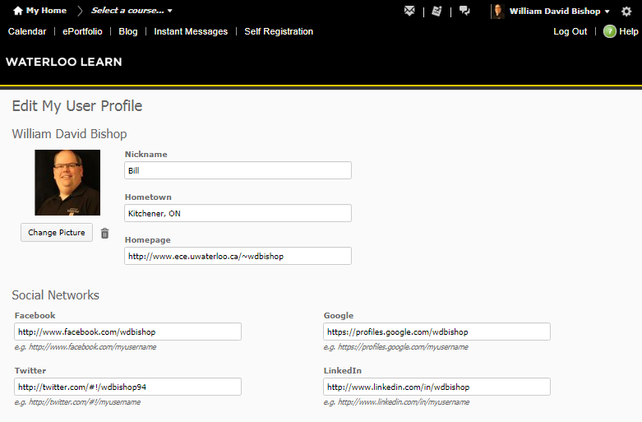
Example of a LEARN Profile

Slide 34
Navigating in LEARN
The most important features are the following:
Course materials can be found by using Course Materials
Discussion forums can be found by using Connect
Submission folders, quizzes, and surveys can be found by using Assessments
Grades can be found by using Grades
To quickly switch between courses, access the dropdown box in the upper left corner of the screen by clicking on the course name

Slide 35
Subscribing to Discussion Forums in LEARN
You should subscribe to discussion forums in LEARN to avoid missing important postings
When you subscribe to a discussion forum, you can instruct LEARN to e-mail you a notification of the posting immediately or you can choose to have LEARN send you a daily digest (summary) of postings:
I recommend requesting an immediate notification of a new posting
To subscribe, click on the word “Subscribe” at the far right on the discussion forum screen

Slide 36
LEARN Accessibility
Due to circumstances beyond the control of the teaching team, LEARN and course websites may, on occasion, be offline for system maintenance
Don’t wait until the last minute for submitting your assignments:
Network traffic is often high around submission deadlines
If you have a slow network connection, you may miss a submission deadline
Remember that submission deadlines are strictly enforced
I highly recommend downloading course notes and important assignment materials to your computer or a USB memory key:
USB memory keys have a limited lifetime
All students should invest in a new USB memory key every academic term

Slide 37
Survey Activities
There are two entrance survey activities that you must complete by Thursday, September 14th at 6:00 pm:
What’s It Like to Come to Waterloo?
Welcome to ECE Survey
Each survey is worth 2.5% of your ECE 190 grade
The surveys are designed to help us understand our students and to continuously improve our program over time
The surveys should require no more than 30 minutes of your time

Slide 38
Assigned Textbook Readings
Recall that you have the following assigned textbook reading:
Chapter 5: Learning Strategies (p. 67 – p. 76)

Slide 39
Lecture 2
Essential Study Skills

Slide 40
Lecture Outline
This lecture will examine the following topics:
Scheduling your time effectively
Staying well informed
Preparing for exams
Staying healthy

Slide 41
Why Do We Advocate Working on Your Study Skills?
University courses are much harder than most secondary school courses
The key differences between university and secondary school are the following:
University courses are compressed into 12 weeks of lectures so you have less time to absorb the material and less time to recover from mistakes
Examinations in university courses are often more difficult than examinations in secondary school courses
University course assignments often require more work to complete successfully
Put simply, a student with poor study skills will struggle with the transition from secondary school to university:
Unfortunately, most students do not know if their study skills are adequate

Slide 42
Scheduling Your Time Effectively
Scheduling your time is important so that you will be able to anticipate busy times and prepare accordingly
You need to prepare three different types of schedules:
A term schedule to keep track of assignment deadlines and examinations
A weekly schedule to keep track of classes, study times, activities, and deadlines
An exam schedule to keep track of exams and studying for exams
Having an effective set of schedules will improve your confidence:
Nothing hurts your confidence more than missing a deadline and receiving a grade of 0 on an assignment

Slide 43
Weekly Schedule
The purpose of your weekly schedule is to identify busy times of the week and to find sufficient time for studying, sleeping, and university life
Review and update your weekly schedule daily:
Remember to allocate time in your schedule to review and update your schedule
Every night, spend a few minutes reviewing your weekly schedule so that you are aware of the tasks you must complete over the next few days
Every morning, briefly review your weekly schedule to refresh your memory

Slide 44
Term Schedule
The purpose of your term schedule is to identify busy times of the term so that you may plan accordingly
Update your term schedule every Sunday:
Make sure you have all of your assignments and examinations on the schedule
Don’t forget to include activities that you feel are important
For example, if you plan to watch Thor: Ragnarok this term, add it to your term schedule so that you will have time to watch the movie
If you will be visiting your parents, put these visits on your schedule:
Keep visits home to a minimum to free up time in your schedule
Studying is difficult when visiting friends and family

Slide 45
Exam Schedule
Prior to midterm exams and final exams, prepare a special exam schedule that takes into account the times of your exams and your extended study hours
Remember that cramming for an exam is not effective:
Memorization of facts is insufficient for most university exams
On exams, you must demonstrate a deeper understanding of your knowledge
Often, the problems are challenging and require several steps to solve
Schedule time to study old exams:
Old exams provided by the instructor are a great resource
If your course instructor does not provide old exams, you can likely obtain some from the Exam Bank organized by the Engineering Society

Slide 46
Stay Well Informed
Here are three suggestions for staying well informed:
Attend all of your scheduled classes
Establish a network of classmates to contact for information
Check LEARN regularly for announcements and updates

Slide 47
Preparing for Exams
When preparing for exams, make sure you attempt to solve the hard problems:
Hard problems are much more likely to appear on exams
Solving simple problems is a waste of your time
Reading the solution to a problem is not the same as solving it yourself
If the assignment problems seem too easy, seek out more challenging problems from textbooks, the exam bank, or other sources:
Resources exist that provide problems with full solutions
Upper year students might also be a great resource for interesting problems
The more problems you solve, the more prepared you will be

Slide 48
Staying Healthy
Staying healthy is very important to your success:
If you are feeling ill or tired, you will not be productive
Some keys to staying healthy are the following:
Every night, get at least 7 hours of sleep and go to bed at a consistent time
Regular (healthy) snacks throughout the day will help you stay alert
Stand up and go for a walk during breaks between classes
Schedule some time each week to get some exercise
Wash your hands well to avoid getting sick

Slide 49
Useful Tip #1: Get a Locker
Lockers provide you with a way to keep your textbooks, supplies, computers, and cellular phones nearby during the day:
Also, lockers are very useful for storing coats and umbrellas on cold, rainy days
Lockers are available for use in a number of locations in E2:
Lockers are available on the 1st floor outside the WEEF Lab (E2 1310)
Lockers are available on the 3rd floor of E2
You may use a locker for an entire term without paying a fee:
Lockers are available on a first-come, first-serve basis
You must supply your own lock
Lockers typically fill up quickly so always try to get one at the start of the term

Slide 50
Useful Tip #2: Establish an Emergency Contact List
You can’t always count on e-mail for a quick response to a question
At the start of every academic term, you should create an emergency contact list that keeps track of the following:
Contact information for course instructors (names, e-mail addresses, offices, and phone numbers)
Contact information for classmates (names, e-mail addresses, and phone numbers)
It is a good idea to keep a printed copy of this emergency contact list in a highly visible location in your residence
You might also wish to keep a copy of the list with you at all times
Let’s establish an emergency contact list now…

Slide 51
Useful Tip #3: Be Proactive
Don’t wait until the last minute to ask questions about assignments:
Get clarifications early
Don’t be afraid to ask questions, particularly on discussion forums
If you wait until the last minute, you may do unnecessary work
Even worse, you might find that you don’t have enough time to finish the assignment properly by the deadline

Slide 52
Useful Tip #4: Get a Success Coach
Students may book an appointment with a Success Coach by contacting the Student Success Office:
You can either e-mail success@uwaterloo.ca or phone 519-888-4567 ext. 84410 to book an appointment
Success coaching can help with the following skills:
Test taking skills
Study strategies
Time management
Note taking and reading skills
Life skills

Slide 53
Useful Tip #5: Attend Drop-In Tutoring Sessions
Free tutoring sessions are available in the university residences:
Despite being offered in the university residences, the tutoring sessions are open to all university students
This Fall, tutoring is available for the following courses:
Course | Day | Time | Location
CHE 102 | Sundays | 6 pm to 9 pm | Village 1 Great Hall
MATH 115 | Sundays | 6 pm to 9 pm | Village 1 Great Hall
MATH 117 | Sundays | 6 pm to 9 pm | Village 1 Great Hall
ECE 105 | Tuesdays | 7 pm to 10 pm | Village 1 Training Room
ECE 150 | Thursdays | 7 pm to 10 pm | Village 1 Great Hall

Slide 54
Useful Tip #6: Get Involved… But Not Too Involved
Participating in an extracurricular activity can be very useful:
You will have an opportunity to meet people outside your class
You will learn new things
You will have something to put on your résumé
However, do not overcommit yourself:
Avoid accepting leadership roles in your 1A term
Focus on a single extracurricular activity
Ensure that your activity does not overlap with examination periods
A physical activity such as an intramural sport would be an excellent choice:
Sports help you achieve a healthy lifestyle
Sports rarely require you taking on a significant leadership role

Slide 55
Assigned Textbook Readings
Recall that you have the following assigned textbook readings:
Chapter 1: An Introduction to Engineering (p. 3 – p. 15)
Chapter 2: The Licensed Professional Engineer (p. 19 – p. 33)

Slide 56
Lecture 3
CFE Session 1 – Résumé Writing

Slide 57
Lecture Outline
This lecture will examine the following topics:
Creating your résumé
What do employers want?
Résumé templates
Résumé tips

Slide 58
Assigned Textbook Readings
Recall that you have the following assigned textbook readings:
Chapter 1: An Introduction to Engineering (p. 3 – p. 15)
Chapter 2: The Licensed Professional Engineer (p. 19 – p. 33)

Slide 59
Lecture 4
The Engineering Profession

Slide 60
Lecture Outline
This lecture will examine the following topics:
Definition of the engineering profession
Regulation of the engineering profession
Professional misconduct
Licensure process

Slide 61
Engineering is a Profession
Samuel C. Florman defines a profession as follows:
“A profession is a self-selected, self-disciplined group of individuals who hold themselves out to the public as possessing a special skill derived from training and education and who are prepared to exercise that skill in the interests of others.”
The Professional Engineers Act defines professional engineering as:
“… any act of designing, composing, evaluating, advising, reporting, directing, or supervising wherein the safeguarding of the life, health, property, or the public welfare is concerned, and that requires the application of engineering principles, but does not include practising as a natural scientist.”

Slide 62
Engineering Regulatory Bodies and Societies
Government of Ontario
Professional Engineers Act
PEO Council Staff and Committees
Professional Engineers Ontario
(PEO)
Engineers Canada
Admission
Practice
Complaints
Discipline
Canadian Engineering Accreditation Board
(CEAB)
LICENSED ENGINEER
Canadian Engineering Societies:
CSCE, CSEE, CSME, CSChE, etc.
International Engineering Societies:
ASCE, IEEE, ASME, AICHE, etc.

Slide 63
The Professional Engineers Act
The Professional Engineers Act (R.S.O. 1990, c. P.28) delegates the responsibility for regulating the engineering profession in the Province of Ontario to “Professional Engineers Ontario (PEO)”
The Act contains provisions for the following:
Regulations
Govern engineering practice
Expand upon clauses of the Act for clear interpretation
Define academic and experience requirements for licensure
By-Laws
Define rules for administering the PEO
Code of Ethics
Define rules for personal conduct
Provide guidance for individual engineers

Slide 64
The Engineer’s Working Environment
Unlike many professions, engineers are rarely self-employed:
This is particularly true for electrical and computer engineers
The general public rarely notes the work of engineers:
Major successes (e.g., Canadarm, Confederation Bridge, etc.)
Major failures (e.g., Tacoma Narrows Bridge, STS-51L, etc.)
Television Shows (e.g., Star Trek, Dilbert, etc.)
Many engineering achievements are appreciated but not recognized by the general public

Slide 65
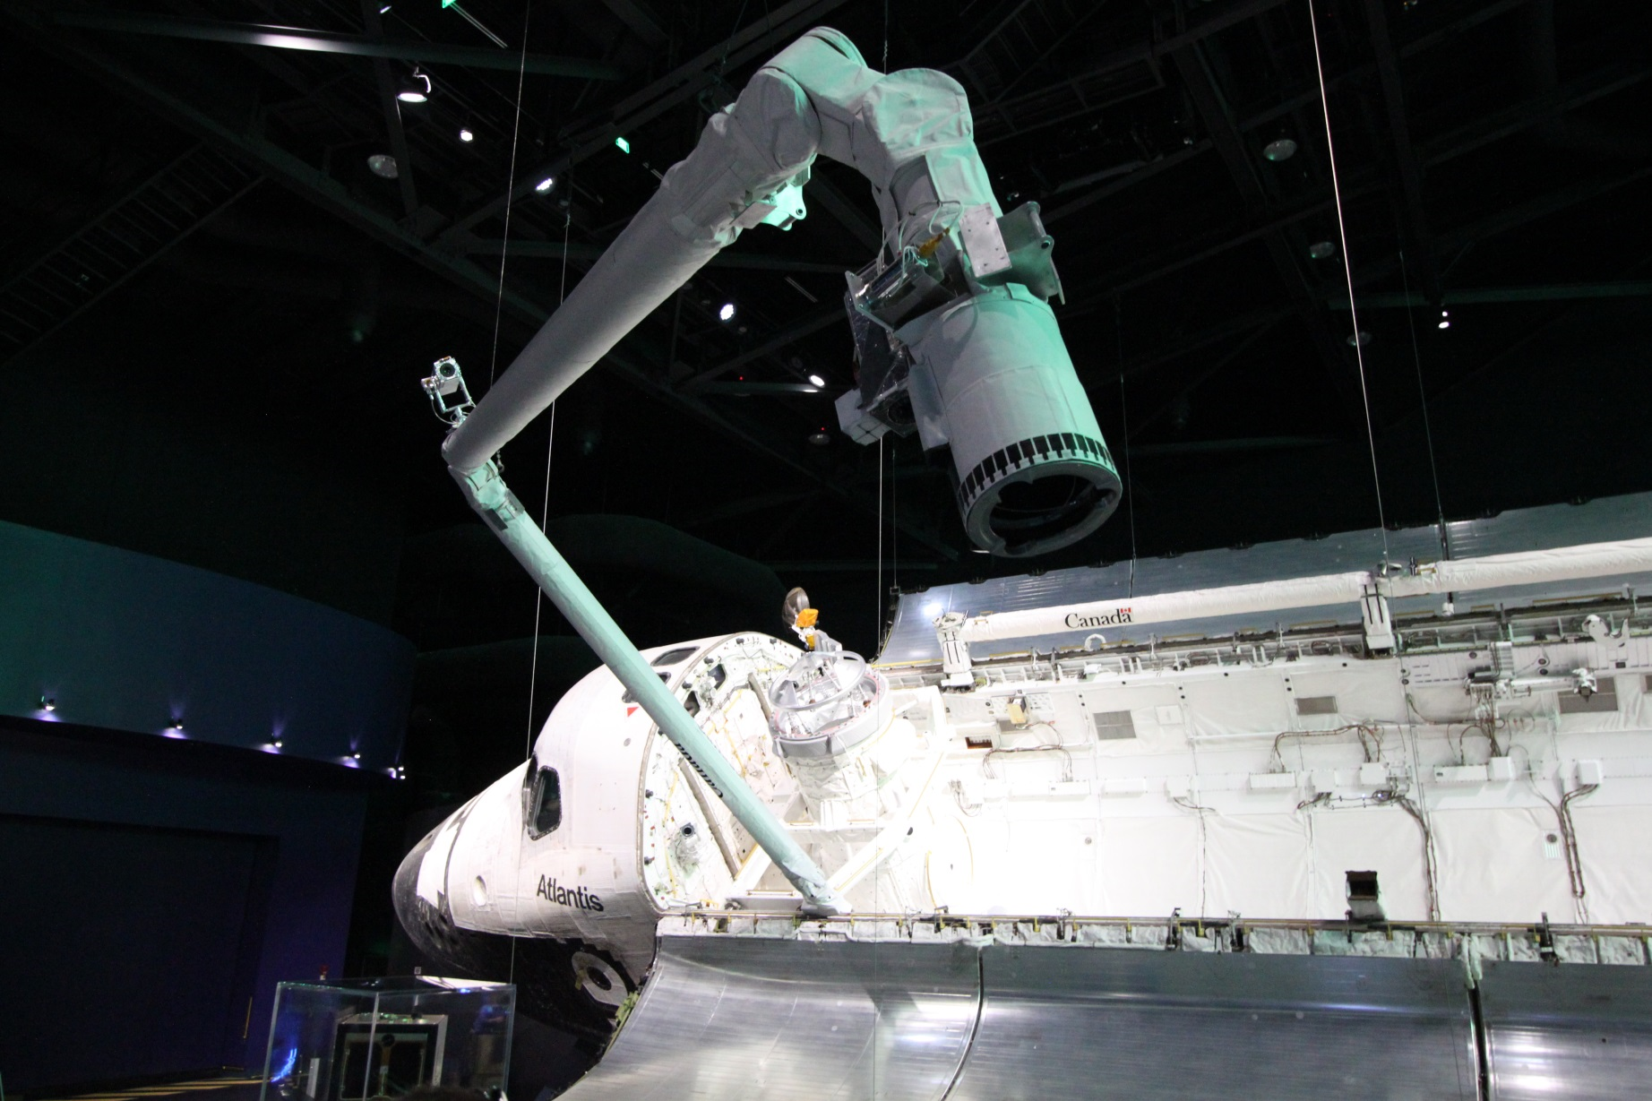
Canadarm

Slide 66
Professional Engineering Titles
Professional engineers are allowed to use a title granted by a licensing body:
“P.Eng.” in Canada and the United States
“ing.” in Canada (for francophones)
“C.Eng.” in the United Kingdom and several other countries
“Eur Ing.” in Europe
A professional engineer must hold a license granted by a legally constituted licensing body such as the PEO

Slide 67
Engineers vs. Professional Engineers
What is the difference between an engineer and a professional engineer?
According to the Professional Engineering Act, only holders of a license may use the word “engineer” in their job title or otherwise imply to the general public that they are entitled to practise professional engineering
How is the title protected?
Engineers Canada (previously the Canadian Council of Professional Engineers) and provincial licensing associations monitor the use of the title
This has led to some interesting cases…

Slide 68
The Microsoft Certified Systems Engineer Case
Professional engineering organizations and Microsoft engaged in a long battle over the use of the designation, “Microsoft Certified Systems Engineer”
In September 2000, the CCPE (Canadian Council of Professional Engineers) met with Microsoft Corporation to discuss the legal implications of the use of the designation
In May 2001, Microsoft Corporation advised all holders of MCSE certification to refrain from the use of the title
In July 2002, Microsoft Corporation resumed the use of the designation
In April 2004, Microsoft Corporation was fined $1,000 by a Quebec court for the continued use of the designation
In October 2005, Microsoft Corporation agreed to comply with the Quebec court’s ruling in the Province of Quebec
MCSE is now an abbreviation for Microsoft Certified Solutions Expert

Slide 69
The Mohammad Hafeez Case
After repeatedly violating the Professional Engineers Act, a Toronto man was jailed for 30 days and ordered to pay $19,863.81 to the PEO
Mr. Hafeez had been previously convicted on four separate occasions as misrepresenting himself as an engineer while working on construction projects in Toronto and the surrounding area
Mr. Hafeez had been previously fined $85,000
For the full story, refer to the following URL:
http://www.peo.on.ca/index.php/ci_id/22060/la_id/1.htm

Slide 70
Professional Conduct
R.R.O. 1990, Regulation 941 clearly defines what engineers should and should not do:
Section 77 (Code of Ethics) defines what engineers should do
Section 72 (Professional Misconduct) defines what engineers must not do
The full text of R.R.O. 1990, Regulation 941 is available online:
https://www.ontario.ca/laws/regulation/900941

Slide 71
Enforcement
The PEO enforces the Professional Engineers Act in the Province of Ontario
The PEO publishes information on disciplinary hearings on its website:
http://www.peo.on.ca/index.php/ci_id/2173/la_id/1.htm
Disciplinary hearings are required to protect the general public from unscrupulous individuals:
Engineers are most often employed by the government or by the general public
The government and the general public cannot be expected to assess quality of an engineer’s products or processes
Enforcement helps ensure the quality of engineering work

Slide 72
Program Accreditation
In Canada, engineering programs are accredited by the Canadian Engineering Accreditation Board (CEAB):
The CEAB is a board of the Canadian Council of Professional Engineers (CCPE)
Program accreditation is not equivalent to licensure:
Graduates of an accredited program do not automatically become licensed professionals in their field of study
The CEAB will be reviewing the accreditation of some engineering programs at the University of Waterloo this year:
Canadian university programs are reviewed periodically by external assessors to ensure that programs meet the standard expected of an undergraduate engineering program

Slide 73
Licensing vs. Certification
The general purpose of both certification and licensing is to verify and provide assurances about the competency of those being certified/licensed
Provincial and state governments mandate the licensing of professionals who are legally required to practice at a level consistent with public safety (doctors, lawyers, and professional engineers)
A professional society voluntarily operates a certification program to authenticate practitioners’ competency and to inspire public confidence in the profession

Slide 74
Requirements for Licensure
To be licensed by the PEO, applicants must:
Be at least 18 years of age,
Be of good character,
Meet stipulated academic requirements established by the PEO,
Fulfill the engineering work experience requirements, and
Successfully complete the Professional Practice Examination (PPE).

Slide 75
P. Eng. Admission Process
Submission of an application
Evaluation of academic qualifications:
(Up to) 20 three-hour examinations, or
Graduation from an accredited Canadian university program, or
Graduation from a foreign institution recognized by Engineers Canada
Professional Practice Examination (PPE):
Exam covering ethics, professional practice, law, and liability
Evaluation of engineering experience:
48 months minimum, including up to 12 months from work-term experience and/or graduation studies
Approval by the Registrar

Slide 76
P. Eng. Admission Process (CANADA)
CEAB Degree
CEAB - Equivalent
Degree
Technologist or
Equivalent Degree
4 Basic Studies
8 to 12 Advanced
Examinations
Confirmatory
Exams
4 Years Acceptable
Work Experience
10 Years Acceptable
Work Experience
Professional Practice Examination

Slide 77
Application for P.Eng. Licensure
When is it best to apply?
It is best to apply for licensure immediately following graduation from an accredited program
Experience requirements do not need to have been obtained prior to the submission of an application
Exemptions for experience
Up to one year of experience credit may be granted for a post-graduate degree
Engineering work experience obtained after the mid-point of an accredited undergraduate degree (e.g., co-op work-terms in engineering fields) can be assessed for experience credit

Slide 78
Certificate of Authorization
Licensure is not sufficient to provide engineering services to the general public in the Province of Ontario
All engineers or corporations providing services to the general public must obtain a Certificate of Authorization
A person supervising engineering work should also have liability insurance
If liability insurance is not possessed, clients must be informed in writing
Usually, lack of liability insurance is a bad sign

Slide 79
Student Membership Program (SMP)
The PEO offers a student membership program for free to all Ontario undergraduate engineering students with proof of full-time registration as a student in an accredited engineering program
Membership offers the following benefits:
Access to the student membership website
Online subscription to Engineering Dimensions
Invitations to attend local events and presentations
Opportunities to have licensure questions answered
All ECE students at the University of Waterloo should immediately apply for membership at the following website:
http://www.engineeringstudents.peo.on.ca/

Slide 80
P. E. Admission Process (U.S.A.)
ABET Degree
Degree from an Accredited
University or College
4 Years Engineering
Experience
8 Years of Engineering
Experience
Fundamentals of Engineering
Exam
Specialization
Exam
6 Letters of Recommendation
(4 from PEs)

Slide 81
Assigned Textbook Readings
Recall that you have the following assigned textbook reading:
Chapter 3: Professional Engineering Ethics (p. 37 – p. 50)

Slide 82
Lecture 5
CFE Session 2 – Interview Skills

Slide 83
Lecture Outline
This lecture will examine the following topics:
Applying for jobs
Types of job interviews
Preparing for an interview
Interview skills

Slide 84
Assigned Textbook Readings
Recall that you have the following assigned textbook reading:
Chapter 3: Professional Engineering Ethics (p. 37 – p. 50)

Slide 85
Lecture 6
Engineering Ethics

Slide 86
Lecture Outline
This lecture will examine the following topics:
PEO Code of Ethics
Professional misconduct
Use of computer software
Use of the engineering seal

Slide 87
Highlights of the PEO Code of Ethics
General duties:
Maintain high ideals of personal honour and professional integrity
Perform professional engineering services with competence
Duty to society:
Regard the practitioner’s duty to public welfare as paramount
Endeavour at all times to enhance public regard for the practitioner’s profession
Duty to employers:
Keep trade secrets and protect confidential information
Disclose all conflicts of interest

Slide 88
Highlights of the PEO Code of Ethics
Duty to clients:
Disclose any conflict of interest that may hinder the rendering of services to the client
Inform clients in writing of any limitations on the practitioner’s services due to the practitioner’s status as an employee
Duty to colleagues:
Co-operate with other professionals working on a project
Refuse to secretly review the work of others
Give proper credit for the work of others
Duty to the profession:
Maintain the honour of the profession and report unprofessional, dishonest, or unethical conduct by any other practitioner

Slide 89
Professional Misconduct and Discipline
Professional misconduct includes:
Harassment
Negligence of duties
Failure to safeguard life or property
Failure to correct or report unsafe situations
Failure to comply with applicable codes
Sealing a drawing not prepared or checked by the practitioner
Working in an area where the practitioner lacks competence
Conflicts of interest
Unprofessional conduct

Slide 90
Common Professional Complaints
Conflict of interest:
A personal preference or financial interest that interferes with a duty to the employer, to the client, or to society
Breach of standards:
Failure to follow commonly accepted design codes and standards
NOTE:
Failure to comply with Ontario Regulation 941 can result in disciplinary actions such as license suspension, license revocation, fines, and imprisonment. The names of offenders are often included on the PEO website in the description of the incidents.

Slide 91
Professional Use of Computer Software
Engineers cannot blame computer software for design flaws
Engineers must:
Be competent in the area in which the tool is being used,
Know the type of assistance provided by the tool,
Understand the theory and assumptions used by the tool,
Know the limits / range of validity of the tool, and
Verify the software’s accuracy.
Hand calculations and independent computer calculations may be used to confirm the tool’s results

Slide 92
Use of the Engineer’s Seal
Only final drawings / documents are sealed
Documents should be clearly marked preliminary or not for construction and not sealed if applicable
A seal implies that documents were prepared or checked by the engineer

Slide 93
The Iron Ring and the Engineering Oath
The iron ring is awarded during the “Ritual of the Calling of the Engineer”
The iron ring is a reminder of an engineer’s obligation to society
The “Ritual of the Calling of the Engineer” is a closed ceremony organized by volunteers
Engineering students in their final term of studies voluntarily take an oath known as the “Obligation of the Engineer”
The oath was written by Rudyard Kipling in 1925
The oath reminds engineers of their obligation to maintain high standards of performance and ethics

Slide 94
Assigned Textbook Readings
Recall that you have the following assigned textbook readings:
Chapter 17: Safety in Engineering Design (p. 263 – p. 273)
Chapter 18: Safety, Risk, and the Engineer (p. 277 – p. 286)

Slide 95
Lecture 7
Team Activity 1: Characteristics of Engineers

Slide 96
Activity Outline
This activity will examine the following topics:
Characteristics of engineers
Characteristics of engineering students
Decision making
Teamwork

Slide 97
Team Activity 1: Characteristics of Engineers
This activity examines the characteristics of engineers and engineering students
In this team activity, you will be put into groups of four students
Each team will discuss answers to the following two questions:
What characteristics or traits do you associate with engineers?
What characteristics or traits do you associate with engineering students?
At the end of the activity, your team will submit a one page, handwritten report summarizing your findings

Slide 98
Team Activity Timing
This activity will proceed as follows:
You will have 5 minutes to perform introductions within your group
You will then have 15 minutes to answer the first question
Answers to the first question will be discussed by the entire class
You will then have 15 minutes to answer the second question
Answers to the second question will be discussed by the entire class
This activity is graded so don’t forget to complete the report!

Slide 99
Assigned Textbook Readings
Recall that you have the following assigned textbook readings:
Chapter 17: Safety in Engineering Design (p. 263 – p. 273)
Chapter 18: Safety, Risk, and the Engineer (p. 277 – p. 286)

Slide 100
Lecture 8
Safety and Risk Analysis

Slide 101
Lecture Outline
This lecture will examine the following topics:
Motivations for safety
Hazards
Liability
Risk management

Slide 102
Motivations for Safety
Personal ethics
Professional responsibility
Regulations and codes
Legal liability
Contract law
Tort law
Product liability law
Pressure from governments and groups

Slide 103
Responsibility of the Design Engineer
Engineers are responsible for ensuring that their designs are safe
Failure to act to correct a potentially dangerous situation and failure to follow codes and standards are examples of professional misconduct
Neglecting health and safety during a design doubles the risk of disciplinary action by Professional Engineers Ontario (PEO)

Slide 104
Professional Misconduct
R.R.O. 1990, Reg. 941, s. 72 states that the following are examples of professional misconduct:
(a) negligence
(b) failure to make reasonable provision for the safeguarding of life, health, or property of a person who may be affected by the work for which the practitioner is responsible
(c) failure to act to correct or report a situation that the practitioner believes may endanger the safety or the welfare of the public
(d) failure to make responsible provision for complying with applicable statutes, regulations, standards, codes, by-laws, and rules in connection with work being undertaken by or under the responsibility of the practitioner

Slide 105
Safety Concerns
Engineers need to consider the safety of the following persons:
Eventual users of manufactured devices, products, or structures
Workers involved in the manufacture or fabrication of devices, products, or structures
In some cases, engineers must also take into account the misuse of devices, products, or structures:
Users may have wide variations in abilities
Minimum skill level should not be overrated
Warning labels should be used to deter inappropriate usage

Slide 106
Hazards
A hazard is anything that has the potential to cause injury, death, property damage, financial waste, or any other undesirable consequence
No engineering design or workplace environment can ever be absolutely free of hazards
The goal of engineering is to reduce the risk of injury or illness to an “acceptable” level
Engineers need methodical procedures to recognize and control hazards

Slide 107
Dealing with Hazards
Identify the hazard
Try to prevent or eliminate the need for creating the hazard
Use control measures at the source, along the path, and at the receiver to reduce the severity of the hazard to an acceptable level
If unsuccessful, take the appropriate remedial action:
Recall unsafe devices
Notify people of danger
Assist injured persons

Slide 108
Principles of Hazard Recognition and Control
Assess the capabilities and limitations of users
Anticipate common errors and modes of failure
Evaluate designs for safety and health
Provide adequate instructions and warnings
Design safe tooling and workstations
Consider maintenance needs
Provide clear indications of danger
Control the build-up of energy
Recall products if necessary

Slide 109
Maintenance Needs Checklist
Most frequently replaced items should be easily accessible
Standard interchangeable parts should be kept in common locations
Designs should be modular for simple field repairs
Products should be clearly identified (e.g., colour-coded wiring)
Safe servicing should be possible
Controls should prevent machines from turning on during maintenance
Storage areas should be provided for special tools
Electrical machines should be grounded to minimize shock hazards
Walking surfaces should provide grip

Slide 110




Industry Standards for Signs
Danger Signs
White Foreground
Red Background
Warning Signs
Black Foreground
Orange Background
Caution Signs
Black Foreground
Yellow Background
Notice Signs
White Foreground
Blue Background
Source: http://www.safetylabel.com/

Slide 111








Workplace Hazardous Materials Information System
Class A
Compressed Gas
Class D, Division 2
Poisonous and Infectious Material:
Other Toxic Effects
Class B
Flammable and Combustible Material
Class D, Division 3
Poisonous and Infectious Material:
Biohazardous Infectious Materials
Class C
Oxidizing Material
Class E
Corrosive Material
Class D, Division 1
Poisonous and Infectious Material:
Immediate and Serious Toxic Effects
Class F
Dangerously Reactive Material
Source: Canadian Centre for Occupational Health and Safety

Slide 112
Sources of Product Liability
Express warranty
Written contract stating expected lifetime of product under normal operating conditions
Implied warranty
Unwritten contract for products to be free from defects and to provide reasonably safe operation
Strict liability
Liability as defined by negligence in R.R.O. 1990, Reg. 941, s. 72
Litigation
Liability established in a court of law
Legal precedents can establish new boundaries for liability

Slide 113
Protecting the Customer
The customer is protected by the following measures:
Safe design (low energy, low heat, etc.)
Quality assurance
Guards and protection systems
Fail-safe design (e.g., failure does not cause a hazard)
Fail-soft design (e.g., failure results in reduced performance)
Warnings and disclaimers
Instructions

Slide 114
Protecting the Engineer
The engineer is protected by the following measures:
Detailed design review records
Detailed production review records
Insurance ($$)
Litigation ($$$$)

Slide 115
Best Practices
Eliminate / minimize workplace hazards
Source control by preventing the hazard at its source
Path control by using preventing the hazard from reaching the user
Receiver control by protecting the user with equipment and proper training
Keep accurate records
Build a business case for safety
Know the safety codes and standards that apply
Follow or exceed all safety codes and standards

Slide 116
The Benefits of a Safe Environment
The following benefits are possible in a safe environment:
Reduced workers’ compensation insurance costs
Improved productivity from reduced error rates
Improved workforce stability
Better quality control resulting from more consistent output
Reduced government involvement to enforce safety standards
Increased confidence in the operating equipment, yielding higher output
Improved communication and employee morale

Slide 117
Codes and Standards
Canadian Standards Association (CSA)
http://www.csa.ca/
American National Standards Institute (ANSI)
http://www.ansi.org/
International Organization for Standardization (ISO)
http://www.iso.org/
International Electrotechnical Commission (IEC)
http://www.iec.ch/
Underwriters Laboratories, Inc. (UL)
http://www.ul.ca/

Slide 118
Evaluating Risk in Design
Evolution of designs naturally leads to an increased level of hazards
Engineers balance increasingly hazardous designs with increasing demands for safety:
How safe is “safe enough?”
What is an “acceptable-level” of risk?
What are the steps to manage risk?

Slide 119
Risk Management Process
Analysis:
Identify the hazards that may occur
Estimate the probability of each hazard occurring
Risk evaluation (assessment):
Generate alternatives to reduce / avoid hazards
Calculate the costs / benefits of alternatives
Management decisions:
Select risks to manage
Implement design decisions
Allocate resources
Control, monitor, and review revised design

Slide 120
Analytical Methods
Systematic methods for safety and risk assessment include the following:
Source-path-receiver analysis (not covered)
Checklists
Hazard and operability studies (HAZOP)
Failure modes and effects analysis (FMEA and FMECA)
Fault tree analysis
Risk assessment via probabilities (not covered)

Slide 121
Checklists
A checklist captures the experience (thought process) of senior (experienced) engineers for junior (inexperienced) engineers:
Checklists indicate things to be evaluated and/or tested
Checklists are often included in the design requirements / design specifications and verified during the design review
Checklists are most useful for evolutionary designs:
Each new design requires adaptation of the checklist
Other analytical methods should also be used

Slide 122
Hazard and Operability Studies (HAZOP)
HAZOP is primarily used by experts in process industries for the purpose of uncovering potential operation hazards
HAZOP consists of the following steps:
Identify nodes / points to study (limit focus)
Evaluate the parameters (characteristics of the process at a node)
Describe the design intent (intended value of parameters)
Analyze the deviations (parameter deviations)
Determine the causes of deviations
Predict the consequences as a result of deviations
Identify the hazards (serious consequences)
Provide guide words to stimulate the investigation of all possible deviations

Slide 123
Failure Modes and Effects Analysis
FMEA method is a bottom-up approach for predicting the reliability of complex systems and developing safety tests
FMEA method consists of the following steps:
List each component / subsystem
Identify each component by part name and number
Describe each component and its function
List the failure modes of each component
Document the effect of each possible failure mode for each component
Determine how each possible failure mode can be detected

Slide 124
Failure Modes and Effects Criticality Analysis
FMECA is the same as FMEA with the exception that an estimate of the criticality of each failure mode is assessed to help prioritize fixes
FMECA adds the following steps to the FMEA method:
Indicate the action to be taken to eliminate the hazards and identify who is responsible for taking that action
Assess the criticality of each failure mode and its probability of occurrence

Slide 125
Fault Tree Analysis
FTA is a top-down approach for predicting reliability
FTA consists of the following steps:
Start with a top event fault
Determine all the events necessary to cause the top event
Analyze each contributing event
Continue to analyze contributing events until the events do not depend on any other events (primary faults or basic faults)
An example of a partial fault tree is provided in the textbook

Slide 126
Safety in Large and Complex Systems
It is difficult to guarantee the reliability of large and complex systems:
Ensuring reliability in tightly-coupled systems is more difficult than doing so in loosely-coupled systems
Response time also influences the difficulty of controlling large systems in the presence of a fault or failure
Feedback from the system is required to handle complex systems
A design is considered robust if the design results in fail-safe or fail-soft conditions in the event of trouble

Slide 127
System Risk
Risk can be considered to be a function of two variables:
The probability p of a hazardous event occurring
The cost c of the consequences of a hazardous event
The risk r is expressed using the following:
r = p · c, or log(r) = log(p) + log(c)
p
10⁰
High Risk
Event Probability
10⁻⁶
r = 10⁰
Low Risk
r = 10⁻²
c
10⁰
10⁶
Event Cost ($)

Slide 128
Expressing the Costs of a Hazard
Some monetary costs tend to be “easy” to predict:
Cost of replacement
Cost of redesign
Legal costs can be very high and often difficult to predict
Societal costs are very difficult to predict:
Cost of resource depletion
Cost of environmental impact
Mortality expresses the risk of the hazard to the human population

Slide 129
Assigned Textbook Readings
Recall that you have the following assigned textbook reading:
Chapter 15: Fundamentals of Engineering Design (p. 223 – p. 245)

Slide 130
Lecture 9
CFE Session 3 – Co-op Foundations

Slide 131
Lecture Outline
This lecture will examine the following topics:
Ranking jobs
The job matching process
Success on the job
Safety on the job

Slide 132
Assigned Textbook Readings
Recall that you have the following assigned textbook reading:
Chapter 15: Fundamentals of Engineering Design (p. 223 – p. 245)

Slide 133
Lecture 10
ECE Program Overview

Slide 134
Lecture Outline
This lecture will examine the following topics:
Curriculum
Degree requirements
Options and minors
Capstone design projects

Slide 135
The Fall 2017 ECE Curriculum
The Fall 2017 ECE curriculum differs substantially from previous years:
Some core courses have been moved earlier or later in the program
Some core courses have become technical electives
Students now have additional choices to make regarding course selection
Changes have also been implemented for students starting in Fall 2018:
As a result, the Fall 2018 ECE curriculum also differs substantially from the Fall 2017 ECE curriculum
You may encounter some course scheduling difficulties if you try to take courses out of sequence

Slide 136
Core Courses
Core courses are courses that all students in a program are required to take in a particular term:
Core courses may not be dropped without failing the term
Core courses may not be taken out-of-sequence
Core courses are sometimes perceived to be more difficult by students since students must take them, regardless of their own interests
You can fail core courses provided you maintain an acceptable term average but you must eventually pass the courses to graduate

Slide 137
Elective Courses
Elective courses are courses that students may choose from lists of courses to meet degree requirements:
Students must take a full course load so all elective slots must be filled
Students must satisfy pre-requisites, anti-requisites, and co-requisites when registering for an elective course
If requisites are not met, students may ask an instructor to override the requisites to allow the student to register for an elective course
Elective courses come in three different forms:
Complementary studies electives
Natural science electives
Technical electives

Slide 138
Degree Requirements
An ECE student is required to take 39 core courses and 11 electives to receive a Bachelor of Applied Science (B.A.Sc.) degree at the University of Waterloo:
This count includes 7 information session courses, 5 technical electives (TEs), 4 complementary studies electives (CSEs), 2 natural science electives (NSEs)
This count does not include milestones such as work-term reports and technical presentation milestones
Extra courses may be taken by students as desired:
On work-terms, a student is charged a course fee to take an extra course
On academic terms, a student may take an extra course for free provided that the student meets the extra course load average requirement

Slide 139
Course Numbers Explained
ECE course numbers generally have three digits:
Undergraduate courses have a program year ranging from 1 to 4
Field codes indicate the specific field of ECE
Course identifiers are used to distinguish courses within a discipline
ECE 150
Program Year
Course Identifier
Field Code

Slide 140
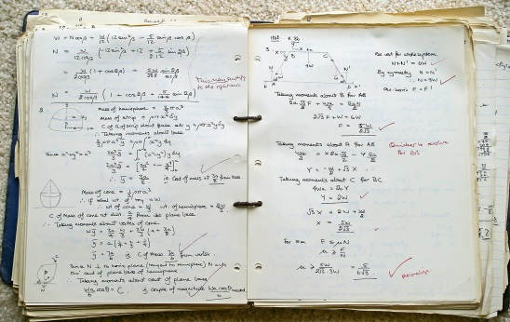


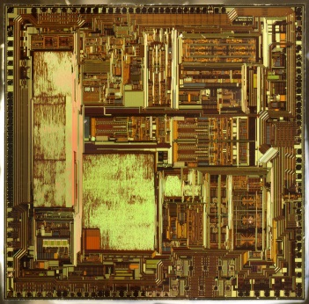
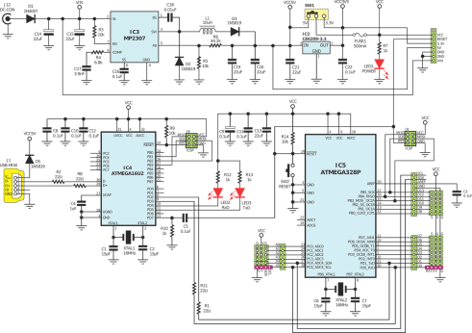





Summary of Course Codes
Images freely available under Creative Commons CC0 courtesy of Pixabay (https://pixabay.com/)
00’s - Mathematics
10’s – Communications
20’s – Hardware
30’s – Silicon Devices
40’s – Circuits
50’s – Software
60’s – Power
70’s – RF / Microwaves / Photonics
80’s – Robotics
90’s – Engineering Design

Slide 141
Curriculum – 1A
Course | Title | LEC | TUT | LAB
CHE 102 | Chemistry for Engineers | 3 | 1 | 0
ECE 105 | Classical Mechanics | 3 | 2 | 1.5
ECE 150 | Fundamentals of Programming | 3 | 1 | 2
ECE 190 | Engineering Profession and Practice | 2 | 0 | 0
MATH 115 | Linear Algebra | 3 | 2 | 0
MATH 117 | Calculus 1 for Engineering | 3 | 2 | 0
English Language Proficiency Milestone
Workplace Hazardous Materials Milestone

Slide 142
Curriculum – 1B
Course | Title | LEC | TUT | LAB
ECE 102 | Information Session | 1 | 0 | 0
ECE 106 | Electricity and Magnetism | 3 | 2 | 1.5
ECE 108 | Discrete Mathematics and Logic 1 | 3 | 1 | 1.5
ECE 124 | Digital Circuits and Systems | 3 | 1 | 1.5
ECE 140 | Linear Circuits | 3 | 2 | 1.5
MATH 119 | Calculus 2 for Engineering | 3 | 2

Slide 143
Curriculum – 2A
Course | Title | LEC | TUT | LAB
ECE 201 | Information Session | 1 | 0 | 0
ECE 204 | Numerical Methods | 3 | 1 | 0
ECE 205 | Advanced Calculus 1 for Electrical and Computer Engineers | 3 | 1 | 0
ECE 222 | Digital Computers | 3 | 1 | 1.5
ECE 240 | Electronic Circuits 1 | 3 | 1 | 1.5
ECE 250 | Algorithms and Data Structures | 3 | 1 | 1.5
ECE 290 | Engineering Profession, Ethics, and Law | 3 | 1 | 0

Slide 144
Curriculum – 2B
Program | Course | Title | LEC | TUT | LAB
BOTH | ECE 202 | Information Session | 1 | 0 | 0
BOTH | ECE 207 | Signals and Systems | 3 | 1 | 0
CE | ECE 208 | Discrete Mathematics and Logic 2 | 3 | 1 | 0
CE | ECE 224 | Embedded Microprocessor Systems | 3 | 1 | 1.5
CE | ECE 252 | Systems Programming and Concurrency | 3 | 1 | 1.5
EE | ECE 206 | Advanced Calculus 2 for Electrical Engineering | 3 | 1 | 0
EE | ECE 209 | Electronic and Electrical Properties of Materials | 3 | 1 | 1.5
EE | ECE 260 | Electromechanical Energy Conversion | 3 | 1 | 1.5
BOTH | ECE 298 | Instrumentation and Prototyping Laboratory | 0 | 0 | 1.5
BOTH | WKRPT 201 | Work-term Report (4 Stream Only)
BOTH | One Complementary Studies Elective, Natural Science Elective, or Technical Elective
BOTH | Technical Presentation Milestone

Slide 145
Curriculum – 3A
Program | Course | Title | LEC | TUT | LAB
BOTH | ECE 301 | Information Session | 1 | 0 | 0
BOTH | ECE 306 | Probability Theory and Statistics | 3 | 1 | 0
CE | ECE 327 | Digital Hardware Systems | 3 | 1 | 1.5
CE | ECE 351 | Compilers | 3 | 1 | 1.5
EE | ECE 340 | Electronic Circuits 2 | 3 | 1 | 1.5
EE | ECE 375 | Electromagnetic Fields and Waves | 3 | 1 | 1.5
BOTH | ECE 380 | Analog Control Systems | 3 | 1 | 1.5
BOTH | WKRPT 201 | Work-term Report (8 Stream Only)
BOTH | WKRPT 301 | Work-term Report (4 Stream Only)
BOTH | One Complementary Studies Elective, Natural Science Elective, or Technical Elective

Slide 146
Curriculum – 3B
Program | Course | Title | LEC | TUT | LAB | Choice
BOTH | ECE 302 | Information Session | 1 | 0 | 0
BOTH | ECE 390 | Engineering Design, Economics, and Impact on Society | 3 | 1 | 1.5
EE | ECE 318 | Analog and Digital Communications | 3 | 1 | 1.5
EE | ECE 331 | Electronic Devices | 3 | 1 | 1.5
BOTH | WKRPT 301 | Work-term Report (8 Stream Only)
BOTH | WKRPT 401 | Work-term Report (4 Stream Only)
BOTH | One Complementary Studies Elective, Natural Science Elective, or Technical Elective
CE | ECE 320 | Computer Architecture | 3 | 1 | 1.5 | Choose 2 of 3
CE | ECE 350 | Real-Time Operating Systems | 3 | 1 | 1.5
CE | ECE 356 | Database Systems | 3 | 1 | 1.5
CE | ECE 318 | Analog and Digital Communications | 3 | 1 | 1.5 | Choose 1 of 2
CE | ECE 358 | Computer Networks | 3 | 1 | 1.5
EE | ECE 360 | Power Systems and Smart Grids | 3 | 1 | 1.5 | Choose 1 of 2
EE | ECE 373 | Radio Frequency and Microwave Circuits | 3 | 1 | 1.5

Slide 147
Curriculum – 4A
Program | Course | Title | LEC | TUT | LAB | Choice
BOTH | ECE 401 | Information Session | 1 | 0 | 0
BOTH | ECE 498A | Engineering Design Project | 1 | 0 | 10 | Choose 1 of 2
BOTH | GENE 403 | Interdisciplinary Design Project 1 | 1 | 0 | 10
BOTH | WKRPT 401 | Work-term Report (8 Stream Only)
BOTH | Four Elective Courses (CSE, NSE, or TE, as Required for Degree Completion)

Slide 148
Curriculum – 4B
Program | Course | Title | LEC | TUT | LAB | Choice
BOTH | ECE 402 | Information Session | 1 | 0 | 0
BOTH | ECE 498B | Engineering Design Project | 1 | 0 | 10 | Choose 1 of 2
BOTH | GENE 404 | Interdisciplinary Design Project 1 | 1 | 0 | 10
BOTH | Four Elective Courses (CSE, NSE, or TE, as Required for Degree Completion)

Slide 149
Co-op Streaming
Term | F17 | W18 | S18 | F18 | W19 | S19 | F19 | W20 | S20 | F20 | W21 | S21 | F21 | W22
4S-Stream | 1A | Co-op 1 PD 20 | 1B | Co-op 2 PD 21 | 2A | Co-op 3 PDE | 2B | Co-op 4 PDE | 3A | Co-op 5 PDE | 3B | 4A | Co-op 6 PDE | 4B
8-Stream | 1A | 1B | Co-op 1 PD 20 | 2A | Co-op 2 PD 21 | 2B | Co-op 3 PDE | 3A | Co-op 4 PDE | 3B | Co-op 5 PDE | 4A | Co-op 6 PDE | 4B
PD 20 Engineering Workplace Skills I: Developing Reasoned Conclusions
PD 21 Engineering Workplace Skills II: Developing Effective Plans
PDE – Professional Development Elective (subject to constraints imposed by ECE Department)
NOTE: ECE students may not take PD 22 due to overlap with ECE 290

Slide 150
Options and Minors
Options and minors allow you to customize your degree to provide you with the knowledge and skills you desire
Both options and minors require a student to take additional courses
An option generally requires fewer additional courses than a minor
Options can often be completed by carefully selecting elective courses and by taking a few additional courses while on a work-term or academic term
Minors usually require 1 or 2 additional academic terms to complete
Scheduling issues make options and minors difficult to accommodate:
Some options and minors are easier to complete than others
Information on minors can be found in the undergraduate course calendar for the department offering the minor

Slide 151
Faculty Options
Option | Restrictions
Biomechanics
Computer Engineering | Only SYDE
Entrepreneurship
Environmental Engineering | All programs except ENVE
International Studies in Engineering
Life Sciences
Management Sciences
Mathematics
Mechatronics
Physical Sciences
Society, Technology and Values
Software Engineering
Statistics
Water Resources

Slide 152
Capstone Design Projects
In your fourth year of studies, you will complete a capstone design project as part of a two course sequence:
The standard course sequence for ECE students is ECE 498A and ECE 498B
An interdisciplinary course sequence consisting of GENE 403 and GENE 404 exists for students wishing to work with students from other engineering disciplines
Your capstone design project provides you with an opportunity to solve an engineering design problem of your choosing:
In your first course, you identify the engineering design problem and work on a first prototype of a solution to the design problem
In your second course, you refine your first prototype of a solution and present the revised solution at a design symposium
The capstone design project provides great opportunities for entrepreneurship

Slide 153
Other Curriculum Opportunities
Other curriculum opportunities exist including:
Combined bachelors / masters programs
Exchange programs (popular in 3rd year of studies)
Double degree programs (extremely rare)
If you wish to customize your degree further, ask an academic advisor:
Academic advisors have the ability to add new courses to eligibility lists, to assess the equivalence of courses, and to enroll students in courses
You can even take a graduate courses for credit if the course fits into your schedule

Slide 154
Assigned Textbook Readings
Recall that you have the following assigned textbook reading:
Chapter 16: Project Management and Scheduling (p. 249 – p. 260)

Slide 155
Lecture 11
Engineering Design

Slide 156
Lecture Outline
This lecture examines the following topics:
Definition of engineering design
Engineering design process
Engineering design models
Systematic decision-making

Slide 157
Formal Definition of Engineering Design
The Canadian Engineering Accreditation Board formally defines engineering design as the following:
“Engineering design integrates mathematics, basic sciences, engineering sciences, and complementary studies in developing elements, systems, and processes to meet specific needs. It is a creative, iterative, and often open-ended process subject to constraints which may be governed by standards or legislation to varying degrees depending upon the discipline. These constraints may relate to economic, health, safety, environmental, social, or other pertinent interdisciplinary factors.”
Put simply, engineering design is the creative application of technical knowledge to solve a problem without causing harm to society

Slide 158
Creativity, Progress, and Engineering Design
“A good scientist is a person with original ideas. A good engineer is a person who makes a design that works with as few original ideas as possible.”
– Freeman Dyson, 1979.
“… (that) any general system of conveying passengers would … go at a velocity exceeding ten miles an hour; or thereabouts, is extremely improbable.”
– Railway Engineer Thomas Treadgold, 1835.
“All parts should go together without forcing. You must remember that the parts you are reassembling were disassembled by you. Therefore, if you can’t get them together again, there must be a reason. By all means, do not use a hammer.”
– IBM Maintenance Manual, 1925.

Slide 159
Types of Engineering Design Solutions
Two types of engineering design solutions exist:
Evolutionary design solutions are those based on improvements to existing design solutions
Innovative design solutions are those based on a completely original idea or a novel way of solving the design problem
Modern engineering designs combine innovation and evolution:
For example, the first airplane was an innovative design but modern airplanes are evolutionary designs
It is often difficult to classify a design solution as purely innovative or evolutionary
Some aspect of a design may be evolutionary

Slide 160
Heuristics, Guidelines, Standards, and Specifications
A design heuristic is a very general rule of thumb based on experience:
Heuristics lead to quick design solutions that often work well but are not guaranteed to do so in all situations
A design guideline is a general rule based on experience and specific knowledge of the design problem:
Guidelines generally provide more detailed information than heuristics
A standard provides more direction on a design solution by stating technical requirements that must be satisfied by the design:
Standards do not provide a complete solution but standards do dictate a set of requirements that must be satisfied by a design solution
A specification provides sufficient detail on a design solution that the design solution may be completely reproduced by an engineer

Slide 161
Overview of the Engineering Design Process
Customer Requirements
Needs Recognition
Revised Functional / Non-Functional
Specifications
Problem Definition
Revised Design
Specifications
Design Criteria Definition
Design Constraints
Design Loop:
Synthesis,
Analysis, and
Decision-Making
Optimization
Evaluation (Design Review)
Communication (Design Report)

Slide 162
Needs Recognition
Needs recognition starts with a list of customer requirements
Customer requirements define the design problem from the perspective of the customer
Customer requirements are rarely specific:
Convenient
Easy-to-use
Simple
Customer requirements should specify a problem, not a solution

Slide 163
Problem Definition
Once the needs of the customer have been recognized, the problem must be defined and the design objectives must be clearly stated
Functional requirements specify the functional behaviour of the system in response to inputs:
Examples of functional requirements for an image processing application might include a list of different filters that must be implemented by the system
Examples of functional requirements might also include performance standards that must be achieved by the system
Non-functional requirements specify characteristics of the system that have nothing to do with the functional behaviour of the system:
Cost, size, and weight are typical examples of non-functional requirements

Slide 164
Design Criteria Definition
Design criteria are the performance standards to be met by the design
Good design criteria allow quantitative assessment
Some examples of design criteria include the following:
Power consumption (with a goal specified in Watts)
Noise generation (with a goal specified in decibels)
Transfer rate (with a goal specified in bits per second)
During design optimization, the goal is to satisfy all design criteria but if one criteria is not met, the project is not deemed a complete failure

Slide 165
Design Constraints
Design constraints are the limitations placed on the designer, the final design, or the manufacturing process
Design constraints may be imposed by management, the environment, or the physical systems involved in the design
Some examples of design constraints include the following:
Total project development cost (with a constraint specified in dollars)
Physical space constraints (with dimension constraints specified in centimetres)
Deadlines for successful completion (with a deadline for completion)
International standards for safety (with a list of applicable codes)
A project must satisfy all design constraints to avoid being deemed a failure

Slide 166
Synthesis, Analysis, and Decision-Making
Synthesis, analysis, and decision-making form the design loop
Synthesis is suggesting ideas or methods to solve the problem
Analysis is calculating the expected result of each idea or method
Decision-making is choosing the best alternative for moving forward
It is not uncommon to repeat the design loop multiple times
Each time the design loop is repeated, the design is refined

Slide 167
Optimization
Optimization involves refining a design using tools and techniques to better satisfy the design criteria
Many engineering tools provide ways of optimizing designs with respect to specific design criteria:
Optimization is a time-consuming process
Optimization takes longer as designs approach the optimum

Slide 168
The Design Review
Design reviews are an independent evaluation process
Evaluation teams attempt to answer the following questions:
Does the designer have a thorough understanding of the design goal?
Have all of the relevant requirements, criteria, and constraints been identified?
Is the overall design plausible for meeting the design objectives?
Does the overall design appear to meet the criteria specified?
Is the performance of the design adequate?
Are there any flaws in the analysis of the design?
Design reviews act as a “sanity check”

Slide 169
On the Importance of Presenting Design Alternatives
For a great discussion of the importance of presenting design alternatives at design reviews, refer to the following online article:
Scott Berkun, “Why Good Design Comes from Bad Design: Understanding Bad Design to Create Good User Interfaces”, http://www.microsoft.com/design/article.aspx?type=stories&key=design, January 31, 2010.
In this article, Scott describes the importance of presenting multiple design alternatives to members of the design review evaluation team:
Presenting the disadvantages of alternative designs avoids the problem of being asked to reconsider design alternatives already discarded
Scott concludes that to truly understand the advantages of a good design, one must consider the disadvantages of a bad design

Slide 170
Communication
The importance of communication in the engineering design process is often under-estimated
Large projects require communication between groups and team members:
Do all team members understand how their components interoperate with other components?
Small projects require communication for the purpose of continuity:
If an engineer leaves the company, will design knowledge be lost?

Slide 171
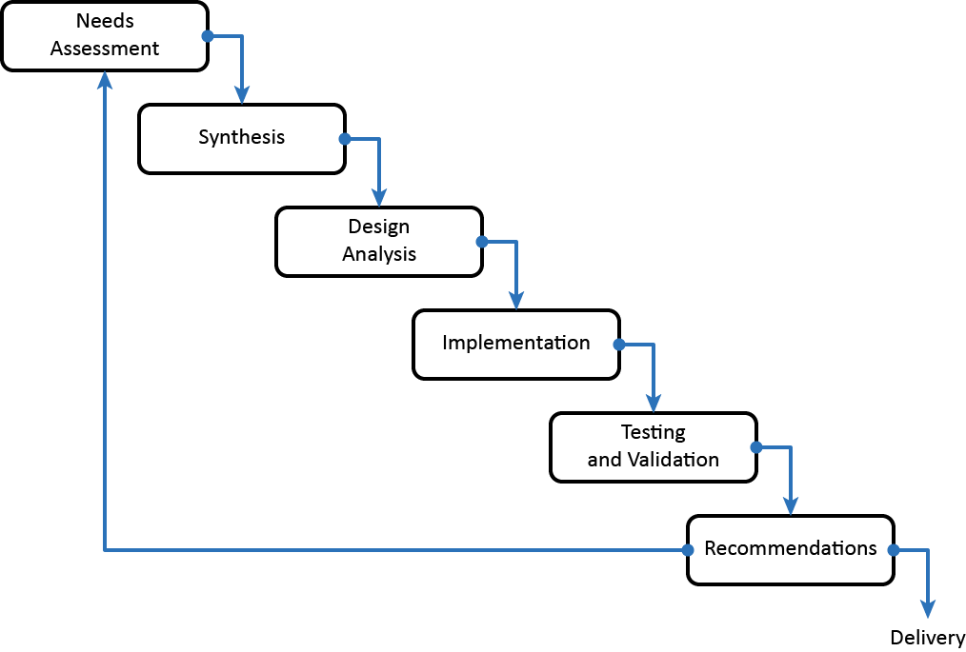
The Waterfall Model of Design

Slide 172
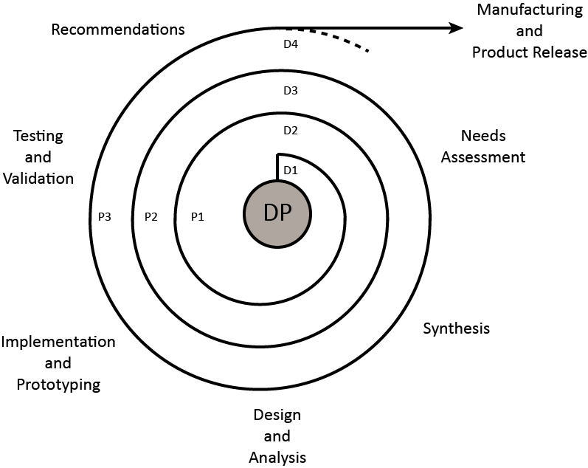
The Spiral Model of Design

Slide 173
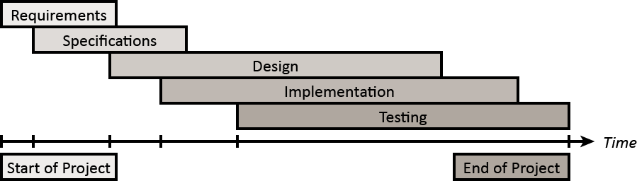
The Concurrent Engineering Model
The concurrent engineering model permits simultaneous progress in the different stages of design:
It is a variation of the Waterfall Model that permits overlapping design stages
This model is sometimes referred to as the Sashimi Model:

Slide 174
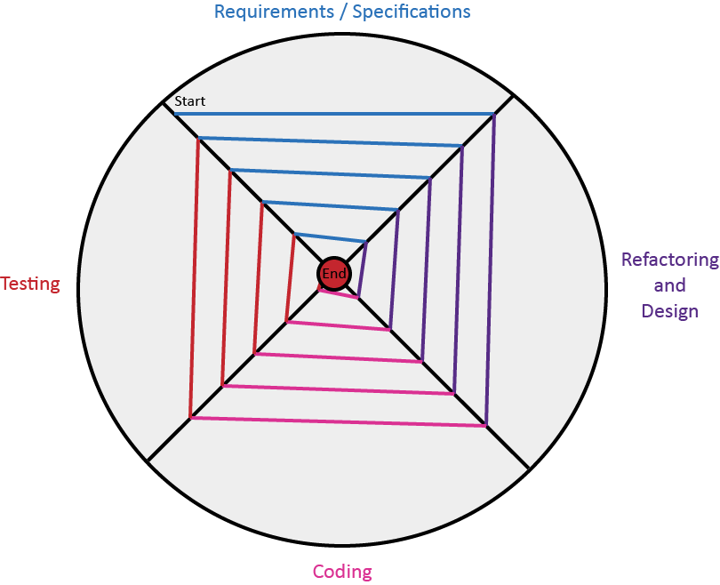
The Extreme Programming Model
The extreme programming model resembles the spiral model of development
The four founding values of the extreme programming model are the following:
Communication
Feedback
Simplicity
Courage
Extreme programming utilizes refactoring in every iteration of the software design process:
Refactoring redesigns and simplifies software designs

Slide 175
Strengths and Weaknesses of Lifecycle Models
Lifecycle Model Capability | Waterfall | Spiral | Concurrent Engineering | Extreme Programming
Works with poorly understood requirements | Poor | Excellent | Excellent | Excellent
Works with poorly understood architecture | Poor | Excellent | Excellent | Fair
Produces a highly reliable system | Excellent | Excellent | Excellent | Excellent
Produces a system with potential for expansion | Excellent | Excellent | Excellent | Excellent
Manages risks | Fair | Fair | Fair | Poor
Can be constrained to a predefined schedule | Fair | Fair | Fair | Poor
Has low overhead | Poor | Fair | Excellent | Fair
Allows for midcourse corrections | Poor | Fair | Fair | Excellent
Provides customer with progress visibility | Poor | Excellent | Excellent | Fair
Provides management with progress visibility | Fair | Excellent | Excellent | Fair
Requires little experience | Fair | Poor | Fair | Poor
Based on material from: Steve McConnell, Rapid Development, pp 156-157, Microsoft Press, 1996.

Slide 176
Systematic Decision-Making
List all choices or courses of action
List all criteria that will be used to evaluate the choices
Compare the two lists and remove impractical choices
Evaluate the advantages and disadvantages of each remaining choice according to all of the criteria

Slide 177
Computational Decision-Making
Suppose the best of m feasible choices is to be found by calculating the payoff functions f₁, f₂, … f_{m} and choosing the largest. The choices are to be evaluated according to n criteria or attributes.
Rank the importance of the criteria and assign weighting constants w_{j}, j = 1, …, n, according to their relative importance, such that the weight constants sum to 1, or 100%. A larger constant indicates a more important criterion
For each alternative i, estimate the fraction p_{ij} to which the alternative satisfies each criterion j

Slide 178
Computational Decision-Making (cont.)
Calculate the total payoff of each of the alternatives i as the weighted sum of criterion fractions:
Choose the alternative with the largest payoff

Slide 179
Arbitrary Criterion Values
Instead of estimating the fractions p_{ij} to which the alternatives satisfy the criteria, use the following:
Assign the amount c_{ij} to which each alternative i satisfies each criterion j. For each criterion j, the units of c_{ij} must be identical but different criteria may be expressed in different units
For each criterion j, calculate
Then

Slide 180
Computational Decision-Making Example
Consider the following important decision:
Where should I attend university?
Surprisingly, it is possible to quantify the effectiveness of solutions to this question
Step 1 involves identifying all of the n criteria in their order of importance:
Quality of Instruction
Cost of Tuition
Proximity to Home

Slide 181
Computational Decision Making Example (cont.)
Step 2 involves assigning weights to each of the criteria:
Quality of Instruction (w₁ = 50%)
Cost of Tuition (w₂ = 30%)
Proximity to Home (w₃ = 20%)
Step 3 involves determining how to assess criteria:
Quality of Instruction… Qualitative assessment (higher = better)
Cost of Tuition… Fees for 1 year of education (lower = better)
Proximity to Home… Qualitative assessment (higher = better)
Since the cost of tuition is inversely proportional to the best solution, the numbers will be inverted so that the best choice is one with a higher score

Slide 182
Data for Assessment
The following data will be used in this assessment:
Criterion | University of Waterloo | University of Toronto | Carnegie Mellon University | Category Winner
Quality of Instruction | 8/10 | 7/10 | 10/10 | Carnegie Mellon University
Cost of Tuition | $10,000 USD per year (0.0001) | $10,000 USD per year (0.0001) | $50,000 USD per year (0.00002) | University of Waterloo / University of Toronto
Proximity to Home | 9/10 | 10/10 | 6/10 | University of Toronto
Note the use of the inverted numbers for tuition. $10,000 USD has been converted to 0.0001 and $50,000 USD has been converted to 0.00002.

Slide 183
Computational Decision Making Example (cont.)
Step 4 involves building a decision matrix:
Criteria | Weight | Alternatives (m = 3)
(n=3) | w_{i} (%) | University of Waterloo |  |  | University of Toronto |  |  | Carnegie-Mellon University
 |  | c_{i1} | p_{i1} | s_{i1} | c_{i2} | p_{i2} | s_{i2} | c_{i3} | p_{i3} | s_{i3}
Quality | 50 | 8 | 0.8 | 40 | 7 | 0.7 | 35 | 10 | 1 | 50
Cost | 30 | 0.0001 | 1 | 30 | 0.0001 | 1 | 30 | 0.00002 | 0.2 | 6
Distance | 20 | 9 | 0.9 | 18 | 10 | 1 | 20 | 6 | 0.6 | 12
Totals f_{j} |  |  |  | 88 |  |  | 85 |  |  | 68
This problem was solved such that the highest score indicates the best choice
It is also possible to setup the decision matrix such that the lowest score indicates the best choice

Slide 184
Potential Flaws in the Analysis
Is the decision to choose the University of Waterloo correct?
Perhaps, but there are some potential flaws in the analysis
Analyzing the potential flaws and their impact upon the decision is important
The values assigned to each of the criteria have different ranges:
Quality ranges from 0.7 to 1.0
Cost ranges from 0.2 to 1.0
Distance ranges from 0.6 to 1.0
The values assigned to the quality criteria are subjective
The weights assigned to the criteria are subjective

Slide 185
Sensitivity Analysis
Could the potential flaws have an impact upon the decision?
A simple sensitivity analysis can help answer whether a change in a value would impact the final decision
A sensitivity analysis is a study of how variations influence the outcome of a mathematical model
A simple way to examine the sensitivity of a decision model to variations is to perform what-if calculations:
Using this approach, simply replace the original value with a variation of the original value and repeat the analysis
This approach assumes that all variables are independent
More complex techniques for sensitivity analysis also exist

Slide 186
Revised Range of Cost Values
If cost values ranged from 0.7 to 1.0, the cost score for Carnegie Mellon University would be increased to 21 (0.7 * 30 = 21):
The revised decision matrix would be the following:
Criteria | Weight | Alternatives (m = 3)
(n=3) | w_{i} (%) | University of Waterloo |  |  | University of Toronto |  |  | Carnegie-Mellon University
 |  | c_{i1} | p_{i1} | s_{i1} | c_{i2} | p_{i2} | s_{i2} | c_{i3} | p_{i3} | s_{i3}
Quality | 50 | 8 | 0.8 | 40 | 7 | 0.7 | 35 | 10 | 1 | 50
Cost | 30 | 0.0001 | 1 | 30 | 0.0001 | 1 | 30 | 0.00002 | 0.7 | 21
Distance | 20 | 9 | 0.9 | 18 | 10 | 1 | 20 | 6 | 0.6 | 12
Totals f_{j} |  |  |  | 88 |  |  | 85 |  |  | 83
The best choice does not appear to change

Slide 187
Revised Quality of Instruction Values
If the quality of instruction for the University of Toronto was rated at 8, the quality score for the University of Toronto would be 40 (0.8 * 50 = 40):
The revised decision matrix would be the following:
Criteria | Weight | Alternatives (m = 3)
(n=3) | w_{i} (%) | University of Waterloo |  |  | University of Toronto |  |  | Carnegie-Mellon University
 |  | c_{i1} | p_{i1} | s_{i1} | c_{i2} | p_{i2} | s_{i2} | c_{i3} | p_{i3} | s_{i3}
Quality | 50 | 8 | 0.8 | 40 | 8 | 0.8 | 40 | 10 | 1 | 50
Cost | 30 | 0.0001 | 1 | 30 | 0.0001 | 1 | 30 | 0.00002 | 0.2 | 6
Distance | 20 | 9 | 0.9 | 18 | 10 | 1 | 20 | 6 | 0.6 | 12
Totals f_{j} |  |  |  | 88 |  |  | 90 |  |  | 68
The best choice changes to the University of Toronto

Slide 188
Revised Criteria Weights
If the weight of the quality criterion was increased to 75% and the weight of the other two criteria were halved, all of the scores in the table change:
The revised decision matrix would be the following:
Criteria | Weight | Alternatives (m = 3)
(n=3) | w_{i} (%) | University of Waterloo |  |  | University of Toronto |  |  | Carnegie-Mellon University
 |  | c_{i1} | p_{i1} | S_{i1} | c_{i2} | p_{i2} | s_{i2} | c_{i3} | p_{i3} | S_{i3}
Quality | 75 | 8 | 0.8 | 60 | 7 | 0.7 | 52.5 | 10 | 1 | 75
Cost | 15 | 0.0001 | 1 | 15 | 0.0001 | 1 | 15 | 0.00002 | 0.2 | 3
Distance | 10 | 9 | 0.9 | 9 | 10 | 1 | 10 | 6 | 0.6 | 6
Totals f_{j} |  |  |  | 84 |  |  | 77.5 |  |  | 84
The University of Waterloo and Carnegie-Mellon University become equally good choices given the revised criteria weights

Slide 189
Characteristics of Computational Decision-Making
Computational decision-making systematically includes diverse factors to arrive at the best decision
This approach requires numerical estimates to represent the importance of criteria and the degree to which the alternatives meet the criteria
Estimates may not be feasible
Estimates may reflect pre-conceived notions
This approach forces the systematic consideration of all criteria for each alternative, even when the numerical coefficients are imprecise
Another example of computational decision-making appears in Introduction to Professional Engineering in Canada in Example 15.3 (p. 232-233)

Slide 190
Assigned Textbook Readings
Recall that you have the following assigned textbook reading:
Chapter 11: Measurement Error (p. 163 – p. 172)
Chapter 16: Project Management and Scheduling (p. 249 – p. 260)

Slide 191
Lecture 12
Team Activity 2: Engineering Design I

Slide 192
Activity Outline
This activity will examine the following topics:
Engineering design
Engineering analysis
Teamwork
Communication

Slide 193
Team Activity 2: Engineering Design II
This activity examines engineering design principles and effective teamwork
In this team activity, you will be put into groups of four students
The goal is to build the highest tower capable of supporting a marshmallow in the time provided
Each team is provided with a kit of materials consisting of the following:
20 sticks of spaghetti
90 cm of tape
90 cm of string
One marshmallow
At the end of the activity, your team will submit a grading sheet completed by a member of the teaching team

Slide 194
Team Activity Timing and Assessment
Each team will have a maximum of 18 minutes to build a tower
Teams must build their towers using only the materials provided:
Replacement materials will not be provided
Towers must be built entirely on the surface of the desk:
Teams may not use walls, chairs, table edges, or other objects to support their towers
The marshmallow must be stable at the height for a least 10 s prior to measurement:
Teams may not touch the tower during measurement

Slide 195
Grading Scheme
Designs will be assigned a grade based on the height achieved
The grading scale is summarized by the following table:
Marshmallow Height | Grade Awarded
80 cm or more | 10
70 cm to 80 cm | 9
60 cm to 70 cm | 8
50 cm to 60 cm | 7
40 cm to 50 cm | 6
30 cm to 40 cm | 5
20 cm to 30 cm | 4
0 cm to 20 cm | 3

Slide 196
Assigned Textbook Readings
Recall that you have the following assigned textbook reading:
Chapter 11: Measurement Error (p. 163 – p. 172)
Chapter 16: Project Management and Scheduling (p. 249 – p. 260)

Slide 197
Lecture 13
Engineering Data Analysis

Slide 198
Lecture Outline
This lecture will examine the following topics:
Measurements and measurement error
Systematic and random errors
Precision, accuracy, and bias
Data analysis using spreadsheets

Slide 199
Measurements
A measurement is a physical quantity that has been observed and compared to a standard quantity, called a unit:
Base units (m, kg, s, K, A, mol, or cd) form the basis for all measurements
Derived units (such as C, V, Ω, F, W, etc.) can be written in terms of base units
Some examples of electrical and computer engineering specific measurements include the following:
Currents (in units of A)
Charge (in units of C = A·s)
Voltages (in units of V = m²·kg·s⁻³·A⁻¹)

Slide 200
Writing Quantities with Units
The following illustrates the convention for writing quantities with units:
Number or formula
Half or full space
SI unit symbols
59.7u² kg
Italic font for variables
Roman (upright) font for numbers and units

Slide 201
Errors
An error is the difference between a measured value and the true value of a variable
Measurement Uncertainty
Real Number System
Measured Value
Error
True Value

Slide 202
Sources of Measurement Errors
Sources of errors include the following:
Systematic errors (i.e., measurement bias)
Random errors (i.e., imprecision)

Slide 203
Systematic Errors
A systematic error is a consistent deviation in a measurement
A systematic error is also called a bias or an offset
Systematic errors have the same sign and magnitude when repeated measurements are made under the same conditions
Three types of systematic errors exist:
Natural error resulting from environmental effects
Instrument error resulting from improper calibration
Personal error resulting from habits of the observer

Slide 204
Random Errors
Random errors result from small variations in measurements
Random errors may be positive or negative
Measurements with random errors have no obvious bias
The average bias approaches 0 as more measurements are taken
Some sources of random errors include the following:
Exerting a different pressure when measuring with a micrometer
Reading a tape measure from different angles
Connecting an instrument in a slightly different fashion each time

Slide 205
Precision, Accuracy, and Bias
Precision:
Precision is a measure of the repeatability of a measurement
Measurements with high precision exhibit very little random error
Bias:
Bias is a measure of the closeness of the average measurement to the true value
Measurements with low bias exhibit very little systematic error
Accuracy:
Accuracy is a measure of the closeness of all measurements to the true value
Accurate measurements have high precision and low bias
Very little total error occurs

Slide 206
Precision, Accuracy, and Bias Examples
Low Precision
High Bias
Low Precision
Low Bias
High Precision
High Bias
High Precision
Low Bias
ACCURATE

Slide 207
Using Spreadsheets to Analyze Data
A spreadsheet is a computerized table of data that allows you to process large amounts of numeric data quickly
You can use spreadsheets to do the following:
Perform repetitive calculations
Compute statistics
Analyze data
Display formatted data
Generate graphs

Slide 208
Spreadsheet Fundamentals
Each location in a spreadsheet is known as a cell
Cells are associated with a data type and an address:
Some common data types include General, Number, Currency, Date, Time, Percentage, Scientific, and Text
Rows in the spreadsheet are labelled using numbers
Columns in the spreadsheet are labelled using letters
When writing formulae, data values may be obtained using the cell location:
For example, writing “= A1 * 5” in cell location A2 will cause Microsoft Excel to compute the product of the value stored in A1 with a value of 5
Alternatively, cell names may be defined to simplify referencing specific cells

Slide 209
Working with Ranges
When working with certain pre-defined functions, it is often necessary to specify a range of values to process
For example, you might wish to compute in cell location A11 the average of a set of values starting at cell location A1 and ending at cell location A10:
To do this, compute the function in cell A11 using “=average(A1:A10)”
The cell range A1:A10 specifies the starting and ending location of the set of values
You can specify rows, columns, or combinations of both as ranges:
For example, the cell range A1:B2 specifies a 2x2 matrix consisting of cell locations A1, A2, B1, and B2
A formula that uses a range is automatically updated by Excel when the formula is copied to another cell in a spreadsheet

Slide 210
Absolute Ranges
It is possible to specify ranges using absolute row and absolute column positions:
To do so, simply insert $ before the row and column positions in the cell reference
For example, the formula =SUM($A$1:$A$10) will refer to the cell range A1:A10
A formula that uses an absolute range is not automatically updated by Excel when the formula is copied to another cell in a spreadsheet
However, absolute ranges are automatically updated by Excel when rows or columns are inserted or deleted from the spreadsheet

Slide 211
Important Excel Functions – Central Tendency
Here is a table of important Excel functions for measures of central tendency:
Function | Description
AVERAGE(number1, [number2], ...) | Returns the average (arithmetic mean) of the arguments. For example, if the range (range: Two or more cells on a sheet. The cells in a range can be adjacent or nonadjacent.) A1:A20 contains numbers, the formula =AVERAGE(A1:A20) returns the average of those numbers.
MEDIAN(number1, [number2], ...) | Returns the median of the given numbers. The median is the number in the middle of a set of numbers.
MODE(number1, [number2], …) | Returns the most frequently occurring, or repetitive, value in an array or range of data.

Slide 212
Important Excel Functions – Spread
Here is a table of important Excel functions for measures of spread:
Function | Description
MIN(number1, [number2], …) | Returns the smallest number in a set of values.
MAX(number1, [number2], …) | Returns the largest number in a set of values.
VAR.S(number1, [number2], …) | Estimates variance based on a sample (ignores logical values and text in the sample).
VAR.P(number1, [number2], …) | Calculates variance based on the entire population (ignores logical values and text in the population).
STDEV.S(number1,[number2],...) | Estimates standard deviation based on a sample (ignores logical values and text in the sample).
STDEV.P(number1,[number2],...) | Calculates standard deviation based on the entire population given as arguments (ignores logical values and text in the population).

Slide 213
Important Excel Functions – Relative Standing
Here is a table of important Excel functions for measures of relative standing:
Function | Description
PERCENTILE.INC(array,k) | Returns the k-th percentile of values in a range, where k is in the range 0..1, inclusive.
QUARTILE.INC(array,quart) | Returns the quartile of a data set, based on percentile values from 0..1, inclusive.

Slide 214
Assigned Textbook Readings
Recall that you have the following assigned textbook reading:
Chapter 19: Environmental Sustainability (p. 289 – p. 310)

Slide 215
Lecture 14
Project Management

Slide 216
Lecture Outline
This lecture will examine the following topics:
Project scheduling
Dependencies
Gantt charts
Critical path analysis

Slide 217
Project Scheduling
Recall the following definitions presented earlier while introducing the topic of planning and estimation:
Planning is the determination of all the activities involved in a project or similar enterprise and their arrangement in a logical order
Scheduling is the assignment of the beginning and end times to the activities
A project schedule is a timeline that summarizes the start dates and end dates for activities and identifies any known dependencies:
The project schedule is part of the project plan
The project schedule is developed once all activities have been identified and arranged in a logical order

Slide 218
Effort vs. Duration
Effort refers to the total amount of work required to complete an activity:
Effort is typically measured in person-hours, person-days, or person-weeks
Effort is calculated by summing all of the hours worked by every member of the team involved in completing the activity
Duration refers to the total amount of time that elapses between the start and end of an activity:
Duration is typically measured in hours, days, or weeks
Duration calculations do not take into account the number of members involved in completing the activity
For example, an activity that requires 5 person-days of work may theoretically be completed in 1 day if 5 (or more) people contribute to the completion of the activity

Slide 219
Overhead
In the context of project scheduling, overhead refers to the amount of additional effort necessary to complete an activity due to project delays, dependencies, and activity coordination:
Put simply, overhead is wasted effort since it is theoretically not required for the completion of the task in an ideal situation
Overhead should always be anticipated for complex activities assigned to a team
Often two people performing an activity requires more effort than one person doing the same activity
For example, an activity that requires 8 hours of effort to complete by one person might require 10 hours of total effort to complete by two people:
Although the total effort is greater, the duration is likely shorter
In this case, the total effort for two people is 10 hours but the duration might be as little as 5 hours

Slide 220
Slack
Slack is the amount of time that an activity may be delayed without causing the end date of the final activity in the project to be delayed as well
A tight schedule has very little slack:
A delay in any activity in a tight schedule will cause a delay in the end date of the project
Parkinson’s Law:
“Work expands so as to fill the time available for its completion.”

Slide 221
Dependencies
Dependencies are relationships between activities and/or resources that have the potential to introduce delays into the timeline of the project
Prior to developing a project schedule, all project dependencies must be identified:
Activities may be dependent upon the initiation or completion of other activities
Activities may be dependent upon the availability of resources

Slide 222
Gantt Charts
Gantt charts establish the timeline for a project
Gantt charts show the following:
Time required for each activity within a project
Ordering of each activity within a project
Project dependencies
Slack time (if applicable)
Companies and agencies often require a Gantt Chart in project plans:
Simple Gantt Charts can be produced using text editors or spreadsheet tools
Complex Gantt Charts can be produced using project management tools

Slide 223
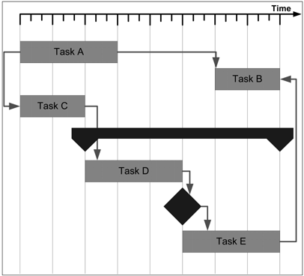
Gantt Chart Example 1
Summary Task
Milestone
From: Andrew Stellman and Jennifer Greene, Applied Software Project Management,
Figure 4-2. Gantt Chart, pp 58, O’Reilly, 2006.

Slide 224
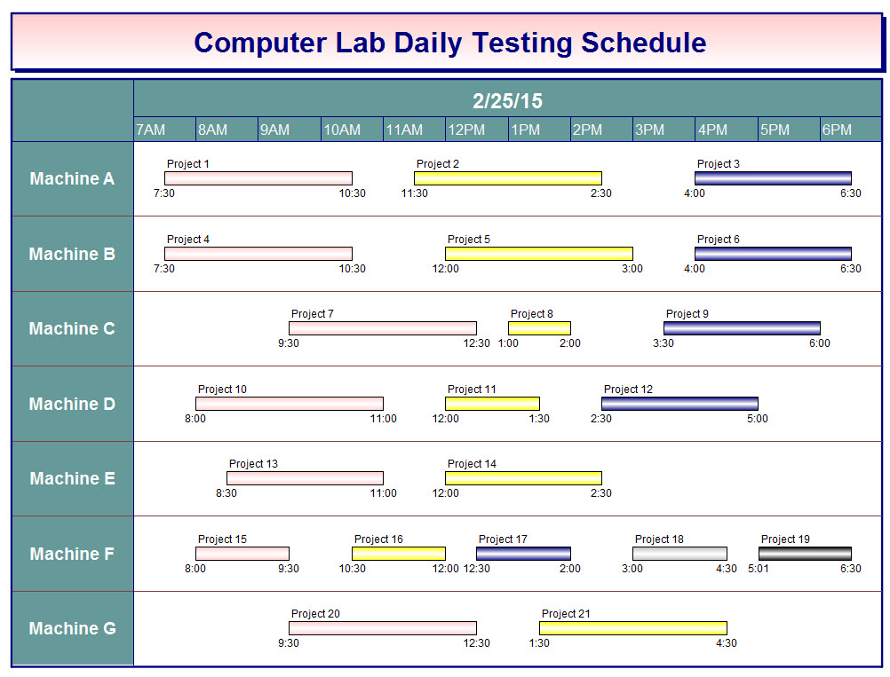
Gantt Chart Example 2
From: Kidasa Software Inc., Milestones Simplicity Schedule Examples, Computer Lab Daily Testing Schedule,
https://kidasa.com/examples/, Accessed August 31, 2017.

Slide 225
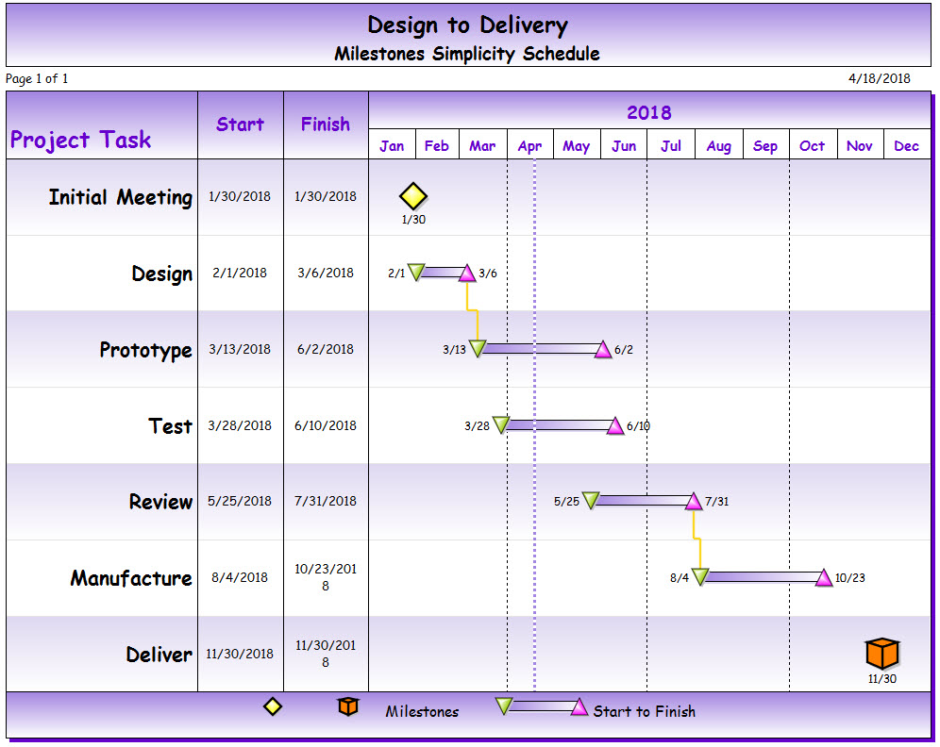
Gantt Chart Example 3
From: Kidasa Software Inc., Milestones Simplicity Schedule Examples, Design to Delivery Schedule,
https://kidasa.com/examples/, Accessed August 31, 2017.

Slide 226
Some Tools for Project Management
Microsoft Project
Aids managers in the managing of schedules and resources
Imports data from spreadsheets and databases
Tracks and analyzes projects
Kidasa Milestones Simplicity
Creates custom project schedules
Imports data from spreadsheets or databases
Builds a wide variety of charts and reports
A comparison of a wide variety of project management software can be found at the following website:
https://en.wikipedia.org/wiki/Comparison_of_project_management_software

Slide 227
Critical-Path Method (CPM)
The critical path method represents a project as a sequence of activities and events
In the context of the critical path method, the following terms are defined:
An activity is any defined job or process that is an essential part of the project
An event is a defined time
Event A
Event B
Activity
A
B
(∆t)
Time t_{A}
Time t_{B}
Δt = t_{B} - t_{A}

Slide 228
Scheduling with CPM
The earliest event (EE) time for an event is the first time at which the activities that precede the event can be completed
To calculate, begin at the start event and determine the longest activity path from the start event to the event in question
The latest event (LE) time for an event is the last time at which the activities that follow the event can commence without delaying the project
To calculate, begin at the end event and determine the longest activity path from the end event to the event in question
The slack time is the difference between the latest event and the earliest event
Events with zero slack time are on the critical path

Slide 229
Representing Event Times using CPM
Each node of the CPM diagram expresses the earliest event time and the latest event time of an event as follows:
Event A
A
Activities
Activities
EE
LE
Earliest Event Time (EE)
Latest Event Time (LE)

Slide 230
Calculating Earliest Event Times
To construct the schedule, first calculate earliest event times by working from left to right as follows:
B
E
2
12
(2)
(3)
(5)
(4)
A
D
G
0
7
16
(4)
(3)
(1)
(3)
C
F
4
8
The earliest event time is the maximum of {2+3,4+3} = 7
The earliest event time is the maximum of {12+4,13+3} = 16

Slide 231
Calculating Latest Event Times
Calculate latest event times by working from right to left as follows:
B
E
2
4
12
12
(2)
(3)
(5)
(4)
A
D
G
0
0
7
7
16
16
(4)
(3)
(1)
(3)
C
F
4
4
8
13
The latest event time is the minimum of {4-2,4-4} = 0
The latest event time is the minimum of {12-5,13-1} = 7

Slide 232
Identifying the Critical Path
B
E
2
4
12
12
(2)
(3)
(5)
(4)
A
D
G
0
0
7
7
16
16
(4)
(3)
(1)
(3)
C
F
4
4
8
13
The critical path of this project consists of events A, C, D, E, and G
The critical path requires a total of 16 time units
There is no slack on the critical path

Slide 233
Illustration of Slack Time
B
E
2
4
12
12
(2)
(3)
(5)
(4)
A
D
G
0
0
7
7
16
16
(4)
(3)
(1)
(3)
C
F
4
4
8
13
Event F has an earliest event time of 8 units and a latest event time of 13 units
The activities that lead to event F have a slack of 5 units
The activity immediately after event F could be delayed by 5 units without delaying the overall project

Slide 234
Buffers
A buffer is an activity inserted into a project schedule to account for unexpected delays:
Buffers are often useful on long projects to account for known delays such as vacation time and planned shutdowns for holidays
Buffers should not be abused:
Buffers should not be inserted to account for poor estimation
If estimates are wrong, the correct way to deal with the situation is to revise the schedule and document the problem:
Doing so ensures that future project schedules will be based on more accurate estimates
Inserting buffers to correct poor estimates will only cause greater uncertainty in future project schedules

Slide 235
Project Metrics
The baseline project schedule is the version of the project schedule approved at the start of the project:
It is understood that the schedule will evolve over time as activities are completed
Some activities will encounter delays while other activities may proceed faster than expected
The variance is a measure of the difference between the estimated effort in the baseline project schedule and the actual effort performed by the team:
Variance is a very important metric to monitor as it is essentially a measure of the accuracy of the approved estimates of effort for project activities
Variances on previous project activities should be carefully considered when estimating effort for upcoming project activities

Slide 236
Other Project Management Diagrams
Several other project management diagrams exist
PERT (Program Evaluation and Review Technique):
A project is represented as a graph of events in a manner similar to the critical path method
In 1958, the US Navy used PERT to reduce the design time of the Polaris missile by 18 months
WBS (Work Breakdown Structures):
A project is represented as a hierarchy of deliverables and tasks
The US Government often requires WBS in their statements of work
Work breakdown structures may be used in combination with Gantt Charts

Slide 237
The Mythical Man-Month
In 1975, Fred Brooks authored a highly-acclaimed book called The Mythical Man-Month: Essays on Software Engineering
This book examines software project management in the context of the development of OS/360
The book makes two interesting observations:
Adding manpower to a late software project makes it later
Writing an Algol compiler requires six months, regardless of the size of the development team
Some people refer to this book as the bible of software engineering

Slide 238
Time Management Wisdom
“Everyone needs deadlines. Even the beavers. They loaf around all summer, but when they are faced with the winter deadline, they work like fury. If we didn’t have deadlines, we’d stagnate.”
– Walt Disney.
Deadlines are often imposed by external factors:
For example, course deadlines are influenced by other courses, the time required to mark assignments, and the deadlines imposed by the Registrar for grade submission
Project managers must consider all known factors when setting project deadlines

Slide 239
Assigned Textbook Readings
Recall that you have the following assigned textbook reading:
Chapter 19: Environmental Sustainability (p. 289 – p. 310)

Slide 240
Lecture 15
Sustainability

Slide 241
Lecture Outline
This lecture will examine the following topics:
Sustainable development
Energy consumption, sustainability, and climate change
The role of the engineer in ensuring sustainability
Steps engineers and individuals can take to ensure sustainability

Slide 242
Introduction to Sustainability
“Sustainable development is development that meets the needs of the present, without compromising the ability of future generations to meet their own needs” [1]
[1] World Commission on Environment and Development, Our Common Future, New York: Oxford, 1987. Brundtland Report, http://www.un-documents.net/wced-ocf.htm (March 9, 2008).

Slide 243
Sustainability Can Be Controversial
Electric Cars:
Are electric cars better or worse for the environment than other types of cars?
Wind Farms:
Are wind farms safe for the environment?
Global Climate Change:
What is the root cause of global climate change?
NOTE:
When engineering any new product or technology, both the benefits and the negative environmental impacts need to be carefully considered…

Slide 244
Negative Environmental Impacts of Electric Cars
Greenhouse Gas Emissions:
The greenhouse gas emissions of electric cars are not obvious
Greenhouse gases result from mining materials, processing materials, transporting materials, generating electricity to charge cars, and recycling materials
Hazardous Waste:
Due to battery limitations, most electric cars have a shorter lifecycle than equivalent gasoline powered cars
Cars must be produced and recycled more frequently
Rare earth metals are difficult to recycle efficiently
http://ieeexplore.ieee.org/stamp/stamp.jsp?tp=&arnumber=6545121
https://www.wired.com/2016/03/teslas-electric-cars-might-not-green-think/

Slide 245
Negative Environmental Impacts of Wind Power
Land Use:
Wind turbines must be spaced approximately 5 rotor diameters to 10 rotor diameters apart
Depending upon the location, 30 acres to 141 acres is required per megawatt of power output capacity
Wildlife and Habitat:
There is evidence of bird and bat deaths from collisions with wind turbines
Deaths can also be caused due to changes in air pressure caused by the spinning turbines as well as from habitat disruption
Public Health and Community:
Sound and visual impact are the two main public health and community concerns
http://www.ucsusa.org/clean-energy/renewable-energy/environmental-impacts-wind-power#.WahQubKGOUk

Slide 246
Achieving Sustainability
To achieve sustainability, society must find ways to do the following:
Effectively and safely dispose of waste products
Avoid the excessive consumption of resources
Manage population growth
Scientists are arguably responsible for identifying problems related to sustainability but engineers are arguably responsible for finding solutions to the problems

Slide 247
Obstacles to Sustainability
Sustainability usually comes at a cost
Some of the obstacles to sustainability are the following:
Lack of understanding of the problem
Cost of solutions
Design effort required to find solutions
Differences of opinion on the solutions

Slide 248
Increasing Awareness of the Need for Sustainability
An increasing awareness of the need for sustainability has been created by the following publications, documentaries, and events:
Silent Spring (1962): Identified pesticides as hazardous to human and animal life
Ehrlich’s Population Bomb (1968): Linked population growth to sustainability
The Brundtland Report (1987): Defined the term “sustainable development”
Montreal Protocol (1987): Linked chlorofluorocarbons to ozone depletion
Rio Summit (1992): Called for a reduction in greenhouse gas emissions
Kyoto Protocol (1997): Established greenhouse gas emission targets
An Inconvenient Truth (2006): Identified climate change as a significant problem
Bali Roadmap (2007): Created intensity-based greenhouse gas emission targets
Paris Agreement (2015): 195 nations pledge to keep temperature rise below 2°C

Slide 249
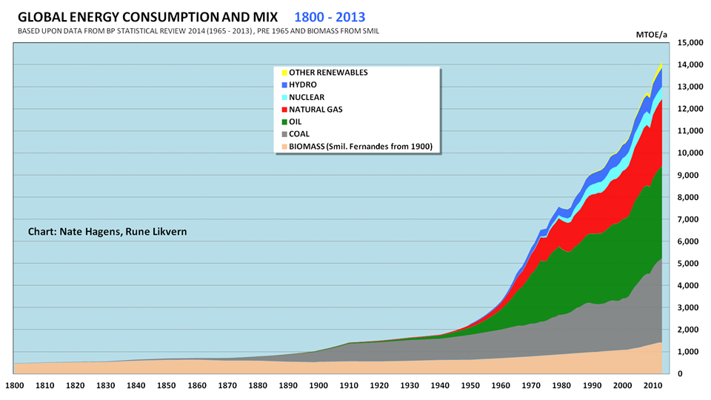
Energy Consumption
https://fractionalflow.com/category/world-energy-consumption/

Slide 250
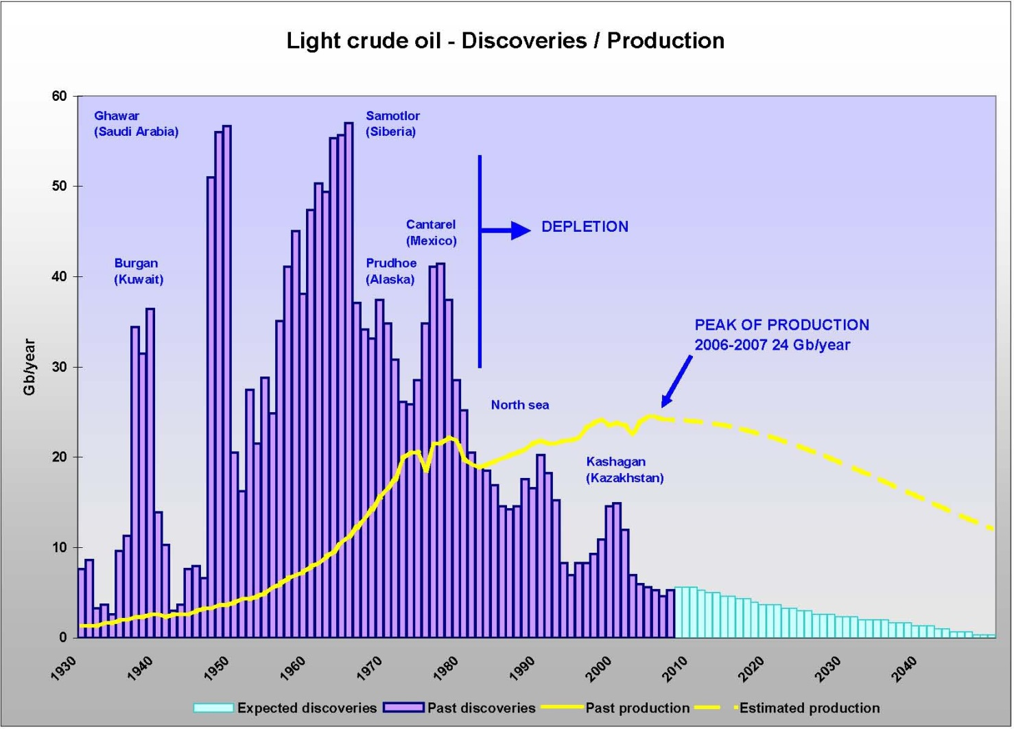
Oil Production and Discovery
http://www.testadepibou.com/pagesEN/Evolutions_ressources.html

Slide 251
Progress is Being Made Every Day
Renewable energy production is on the rise
https://data.oecd.org/energy/renewable-energy.htm
http://www.ren21.net/wp-content/uploads/2016/06/GSR_2016_Full_Report.pdf
Foreign governments are attempting to reduce air pollution
http://news.nationalgeographic.com/2017/05/china-air-pollution-solutions-environment-tangshan/
https://www.thestar.com/news/world/2017/01/19/beijing-spending-27-billion-to-clean-up-air-pollution.html
Manufacturers are designing products to be recycled
https://www.apple.com/ca/environment/
https://www.tesla.com/en_CA/blog/teslas-closed-loop-battery-recycling-program

Slide 252
The Role of the Engineer in Sustainability
Engineers play a significant role with respect to environmental sustainability:
Engineers must understand the environmental consequences of their designs
Engineers must strive to preserve the environment
Engineers must anticipate rather than react to environmental issues
Compliance with environmental regulations is an absolute must however engineers should set a higher goal of achieving environmental sustainability

Slide 253
What Can Individuals Do?
Here are a few simple things that individuals can do to improve environmental sustainability:
Use resources wisely (reduce, reuse, and recycle)
Carpool or take public transit
Participate in activities that cleanup the environment
Make energy efficient choices
Buy local products
Conduct research and development into environmental sustainability

Slide 254
Interesting Videos Related to Sustainability
Here are some interesting videos on the subject of sustainability that students might wish to watch:
A Way Forward: Facing Climate Change [7:43]
http://video.nationalgeographic.com/video/way-forward-climate
Great Energy Challenge [1:40]
http://video.nationalgeographic.com/video/great-energy-challenge
Tuamotus [3:42]
http://video.nationalgeographic.com/video/tuamotus

Slide 255
Assigned Textbook Readings
Recall that you have the following assigned textbook reading:
Chapter 20: The Engineer in Business (p. 317 – p. 326)

Slide 256
Lecture 16
CFE Session 4: Co-op Continuous Placement

Slide 257
Lecture Outline
This lecture will examine the following topics:
Searching for jobs in continuous placement
Participating in interviews
Ranking employers
Updating profiles in WaterlooWorks for continuous placement

Slide 258
Assigned Textbook Readings
Recall that you have the following assigned textbook reading:
Chapter 20: The Engineer in Business (p. 317 – p. 326)

Slide 259
Lecture 17
Business and Entrepreneurship

Slide 260
Lecture Outline
This lecture will examine the following topics:
Classification of businesses and business structures
Successful business concepts
Starting a business
Entrepreneurship resources

Slide 261
Legal Business Structures
Businesses are classified into the following legal business structures:
Unincorporated Sole Proprietorship
Partnership
Incorporated Business

Slide 262
Unincorporated Sole Proprietorship
All assets and liabilities are personal and unlimited:
If the business loses money, the proprietor is responsible for all liabilities of the sole proprietorship
Proprietor assumes all risk associated with business operation
Proprietor finances business using personal wealth, personal debt (e.g., mortgage or loan), or personal connections
For taxation, the profits and losses of the proprietorship are combined with the personal income of the proprietor
Control is maintained by the proprietor
The business name must be registered with a provincial agency if the name of the business is different than the name of the proprietor

Slide 263
Partnership
Two or more proprietors may form a partnership
Each partner is legally responsible for all liabilities of the partnership
For the purpose of taxation, the profits and losses of the partnership are included (proportionally) in the personal income of the partners:
However, partnerships with more than five partners have additional tax reporting requirements
Partnerships are automatically dissolved if any partner dies or becomes bankrupt, unless a partnership agreement states otherwise

Slide 264
Partnership Agreement
A partnership agreement is optional
A partnership agreement establishes the rights, responsibilities, and obligations of each partner:
Some partners are silent
Others may participate in the daily operation of the business
All partners are legally responsible for liabilities

Slide 265
Incorporated Business
A corporation is a separate legal entity registered provincially or federally
Corporations are legally responsible for debts and taxes
Shares represent corporate ownership
All corporations have shares
A single person may own all shares
Different classes of shares may exist (e.g., voting, non-voting, etc.)
Incorporating a business is an expensive proposition
Incorporation fees are larger than registration fees for partnerships and unincorporated sole proprietorships
Reporting of income and losses can be expensive

Slide 266
Advantages and Disadvantages of Incorporation
Advantages
Incorporation separates ownership of the business from the liability for debts
Corporate tax laws differ from personal income tax laws
Ownership may be split amongst thousands of investors
Organization may be privately-owned or publicly-traded
Disadvantages
Incorporation increases the cost of business registration
Additional financial reporting is required
Publicly-traded corporations must publish audited financial statements annually

Slide 267
Steps to Incorporation
Once a business plan has been developed, the following steps are required to incorporate a business:
Determine company type and structure
Determine an operating name
Determine a legal name (a numbered company in the Province of Ontario)
Complete and file Articles of Incorporation

Slide 268
Corporate Structure
Officers are responsible for ensuring the daily operation of the corporation:
Officers are legally able to bind the corporation to contracts
Officers need not be company employees
Examples of officers include Presidents, Vice-Presidents, Treasurers, and Corporate Secretaries
Directors are responsible for setting the strategic direction of the corporation:
Directors are nominated by the officers of the corporation and elected by the shareholders of the corporation
Directors elect a Chairman of the Board to chair meetings
Boards often consist of a mixture of company employees, investors, and successful leaders of industry

Slide 269
Shareholders
Corporations are not owned… only shares are owned
Shareholders can participate in Annual General Meetings (AGMs) and General Meetings (GMs):
Agenda for AGMs and GMs must be announced to shareholders in advance
Shareholders with voting shares may vote on motions
Shareholders votes are weighted based on the number of voting shares they hold

Slide 270
Keys for Starting a Successful Business
The keys for a successful business are the following:
The business concept
Understanding the market
Industry health and trends
Consistent business focus and clear strategic position
Capable management
Ability to attract, motivate, and retain employees
Financial control
Anticipating and adapting to change
Company values and integrity

Slide 271
Successful Business Concepts
Successful businesses incorporate at least one of the following concepts:
Something new
Something better
An underserved or new market
A new delivery system or distribution channel
Increased integration

Slide 272
The Creativity Spectrum
Inventor → Uses unrelated elements to solve previously unsolved problems
Innovator → Implements new concepts or improves existing designs
Entrepreneur → Establishes a company to fill a business void
Manager → Directs a company by creating policies and strategies
Administrator → Implements policies and strategies
NOTE:
One person is unlikely to possess all of these skills and capabilities.

Slide 273
The Business Plan
Business plans are written to serve two purposes:
To examine the problems, pitfalls, and opportunities that exist
To raise capital, attract key personnel, impress customers, and appease suppliers
Business plans provide a roadmap for success:
Plans may expose weaknesses in logic or timing
Plans may identify keys to success

Slide 274
The Business Plan Structure
A business plan typically has the following structure:
Introduction
Front matter (e.g., title page, abstract, privacy statement, etc.)
Executive summary (3 pages maximum)
Concept description
Industry background
Plan
Production plan
Marketing plan
Corporate plan
Financial plan
Risk Analysis
Risk assessment
Worst-case and best-case summary
Appendices (e.g., patents, research material, etc.)

Slide 275
Entrepreneurship Resources at UW
Entrepreneurs Association of the University of Waterloo:
Teaches students about starting companies and provides networking opportunities with leaders of industry
Enterprise Co-op:
Funds and mentors co-op students to start ventures on their work terms
Velocity Residence:
Provides students with an opportunity to live in an innovative and entrepreneurial environment on campus
Velocity Garage:
Provides space for new ventures to develop and test ideas

Slide 276
Engineer of the Future Trust
The Dean of Engineering has established the Engineer of the Future Trust to support early stage ventures by engineering students at the University of Waterloo
A student is eligible to apply for funding if the following requirements are satisfied:
The Student must be a registered undergraduate Faculty of Engineering student or recent (within 1 year) graduate of the Faculty of Engineering
If applying on behalf of a capstone design team, at least 50% of the team must be registered undergraduate students in the Faculty of Engineering.
Project funding may range from $1,000 to $5,000 and above, based on the merit of the proposal

Slide 277
Entrepreneurship Resources Outside the University
A few valuable entrepreneurship resources outside the university that students should learn about include the following:
Y Combinator
Accelerator Centre
Waterloo Accelerator Centre
Stratford Accelerator Centre
Communitech Hub
Kickstarter
Indiegogo
Many companies founded by University of Waterloo students have been funded through Y Combinator including the following:
BufferBox, Vidyard, Pebble, and Thalmic Labs

Slide 278
Assigned Textbook Readings
Recall that you have the following assigned textbook reading:
Chapter 21: Intellectual Property (p. 329 – p. 341)

Slide 279
Lecture 18
WatPD (LEC 001 and LEC 003)
CFE Session 5 – Workplace Harassment and Your Rights (LEC 002)

Slide 280
Lecture Outline
This lecture will examine the following topics:
WatPD core courses
WatPD elective courses

Slide 281
Assigned Textbook Readings
Recall that you have the following assigned textbook reading:
Chapter 21: Intellectual Property (p. 329 – p. 341)

Slide 282
Lecture 19
Intellectual Property

Slide 283
Lecture Outline
This lecture will examine the following topics:
Definition of intellectual property
Classification of intellectual property
Protection of intellectual property
Examples of intellectual property

Slide 284
Intellectual Property (IP)
According to The American Heritage® Dictionary of the English Language, Fourth Edition, intellectual property is the following:
“A product of the intellect that has commercial value, including copyrighted property such as literary or artistic works, and ideational property, such as patents, appellations of origin, business methods, and industrial processes.”
Intellectual property is any tangible idea or invention
Engineers are often responsible for the development of new designs and improvements to existing designs
Engineers need to be able to answer the following questions:
How is ownership of intellectual property established?
How is ownership of intellectual property protected?

Slide 285
Classification of Intellectual Property
Intellectual property can be classified as follows:
Patents
Copyrights
Industrial Designs
Trademarks
Integrated Circuit Topographies
Trade Secrets

Slide 286
Intellectual Property Databases
Searchable intellectual property databases are important sources of information:
Allow designers to search for intellectual property right infringements
Provide a repository of intellectual property for reference
Intellectual property databases are typically maintained by governmental organizations
Some governmental organizations that maintain databases of intellectual property include the following:
Canadian Intellectual Property Office (http://cipo.ic.gc.ca/)
United States Patent and Trademark Office (http://www.uspto.gov/)
World Intellectual Property Organization (http://www.wipo.int/)

Slide 287
Why is Intellectual Property Protected?
Laws and conventions give the creator (inventor, designer, author, artist, etc.) ownership of the intellectual property
Without protection, it may not be economical / practical to research and/or develop ideas and inventions
For example, the substantial investment required for drug research and development can only be justified if intellectual property rights are protected
http://web.mit.edu/newsoffice/nr/2002/novartis.html
Novartis invested $250 million dollars US to establish a state-of-the-art drug research facility on the MIT campus

Slide 288
Patents
Description:
A patented invention must be something new, useful, and ingenious
Applicable Laws:
Patent Act (R.S.C., 1985, c. P-4)
Protection:
Patents give inventors the right to exclude others from making, using, or selling an invention
Protection Duration:
From the day the patent is granted to a maximum of 20 years after the day on which the patent application was filed
Application Requirements:
Canada, like many countries, extends patents to the person who is the first-to-file rather than the person who is first-to-invent

Slide 289
Patent Limitations
Patents can be granted to any of the following inventions:
Products
Apparatuses
Manufacturing processes
Chemical compositions
Improvements to existing inventions (products, apparatuses, manufacturing processes, or chemical compositions)
Patents are not granted for scientific principles, abstract theorems, ideas, methods of conducting business, computer programs, or medical treatments:
Some exceptions apply, particularly with respect to computer software

Slide 290
Patent Applications
The patent application process is complex
Registered agents usually assist with the process
The process includes the following steps:
Conducting a preliminary search
Preparing an abstract
Providing a clear and complete description of the invention and its usefulness
Preparing a list of claims to define the limits of protection to be extended
Submitting drawings to document the invention
A provisional patent application helps establish an inventor as the first-to-file

Slide 291
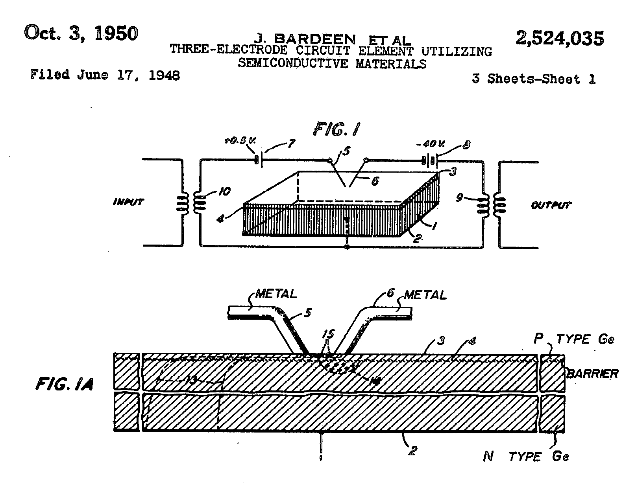
U.S. Patent 2,524,035: The Transistor
U.S. Patent 2,524,035
...to amplify or otherwise translate electric signals or variations by use of compact, simple, and rugged apparatus of novel type. Another object is to provide a circuit element for use as an amplifier or the like which does not require a heated thermionic cathode for its operation, and which therefore is immediately operative when turned on. A related object is to provide such a circuit element which requires no evacuated or gas-filled envelope.

Slide 292
Copyrights
Description:
A copyright protects any original literary, dramatic, musical, or artistic work
Applicable Laws:
Copyright Act (R.S.C., 1985, c. C-42)
Protection:
Copyright includes the right to reproduce, perform, publish, translate, convert, distribute, exhibit, and to lease, or to authorize any such acts
Protection Duration:
The life of the author plus 50 years
Application Requirements:
Copyright registration currently costs $50 CDN (online) or $65 CDN (paper application) but it is not necessary for protection in Canada

Slide 293
Copyright Limitations
Copyright specifically applies to original literary, dramatic, musical, and artistic works such as the following:
Literary works (books, pamphlets, poems, and other works consisting of text including computer programs)
Dramatic, musical, and artistic works
Recordings (often copyrighted separately)
Copyright does not extend to facts, ideas, news, names, slogans, or short phrases, titles, methods, plots, or characters
An employer usually owns the work of employees:
As part of an employee’s contract, copyrights are typically transferred to the employer

Slide 294
Copyright Infringement Examples
The following are examples of copyright infringement:
Reprinting an article without permission
Installing copyrighted software beyond the terms of the license
Playing personal CDs in public without permission
Producing a copyrighted play without permission
The following are not examples of copyright infringement:
Quoting a brief attributed portion of a work
Making and storing a single copy of a software package
Playing personal CDs in your home or your car
Producing a play by Shakespeare

Slide 295
Industrial Designs
Description:
An industrial design is the fixed, visible shape, pattern, or ornamentation applied to a useful article that is mass-produced
Applicable Laws:
Industrial Design Act (R.S.C., 1985, c. I-9)
Protection:
Registration is required to prove exclusive ownership and to protect against infringement
Protection Duration:
5 years from the date of registration and renewable for another 5 years
Application Requirements:
Applications must be made within the first year of public use and designs are assessed on the basis of originality

Slide 296

Example of an Industrial Design
“Spirit of Ecstasy”, Rolls Royce, https://en.wikipedia.org/wiki/Spirit_of_Ecstasy.

Slide 297
Trademarks
Description:
A trademark is a word, symbol, or design used to identify wares or services of a person or company
Applicable Laws:
Trademarks Act (R.S.C., 1985, c. T-13)
Protection:
Registration is required to prove exclusive ownership and to protect against infringement
Protection Duration:
15 years from the date of registration and protection is renewable indefinitely
Application Requirements:
First person to use the trademark in Canada or register the trademark in another country

Slide 298



Types of Trademarks
Three types of trademarks exist:
Ordinary marks distinguish articles or services
Certification marks indicate a quality standard for a product or service
A distinguishing guise is a wrapping, shape, packaging, or appearance that distinguishes a product from other similar products

Slide 299
Integrated Circuit Topographies
Description:
The 3-dimensional configuration of the layers of semiconductors, metals, insulators, and other materials used to implement an integrated circuit
Applicable Laws:
Integrated Circuit Topography Act (S.C. 1990, c. 37)
Protection:
Excludes others from reproducing or utilizing the topography or significant portions of the topography
Protection Duration:
10 years from the date of application or the date of commercial application, whichever is earlier
Application Requirements:
2 years within commercial exploitation of the topography

Slide 300
Trade Secrets
Description:
A way of protecting any type of intellectual property
Applicable Laws:
Contract law, employment law, and the Professional Engineers Act
Protection:
Excludes others from disclosing the intellectual property
Protection Duration:
Protection is maintained indefinitely by preventing those knowledgeable of the trade secret from revealing the trade secret
Application Requirements:
No application process exists

Slide 301
Non-Disclosure Agreements
Non-disclosure agreements are a popular way to enforce trade secrets:
Employees, including co-op students, may be required to sign Non-Disclosure Agreements (NDAs) to preserve trade secrets
If asked to sign a non-disclosure agreement, read the agreement carefully:
Once you sign the agreement, it is too late to modify its terms
Prior to signing the agreement, you can ask to have the agreement modified
Some non-disclosure agreements have terms that could legally prevent you from working for a competing company for several years

Slide 302
Assigned Textbook Readings
Recall that you have the following assigned textbook reading:
Chapter 4: Engineering Societies (p. 55 – p. 63)

Slide 303
Lecture 20
CFE Session 5 – Workplace Harassment and Your Rights (LEC 001 and LEC 003)
WatPD (LEC 002)

Slide 304
Lecture Outline
This lecture will examine the following topics:
Workplace harassment
Your rights as a co-op student
WatPD core courses
WatPD elective courses

Slide 305
Assigned Textbook Readings
Recall that you have the following assigned textbook reading:
Chapter 4: Engineering Societies (p. 55 – p. 63)

Slide 306
Lecture 21
Engineering Societies and Networking

Slide 307
Lecture Outline
This lecture will examine the following topics:
Types of engineering societies
Roles of engineering societies
Importance of networking
Networking tools

Slide 308
The Purpose of Engineering Societies
Engineering societies perform the following roles:
Publish technical information
Develop technical codes and standards
Encourage engineering research
Organize engineering meetings and conferences
Organize engineering design competitions for students and researchers
Provide online learning materials
Advocate on behalf of their members, when appropriate

Slide 309
Advocacy
Provincial engineering associations cannot advocate on behalf of engineers without potentially creating a conflict of interest:
The primary goal of provincial engineering associations must always be to protect the public
A conflict arises if the best interests of the public do not align with the best interests of individual engineers
However, engineering societies may advocate on behalf of engineers:
Many different types of engineering societies exist
Membership in one or more societies is voluntary but recommended

Slide 310
Importance of Engineering Societies
Engineering societies play an important role in helping engineers to maintain their technical competence:
Provincial engineering associations have established programs to monitor the competency of their members after licensure
Maintaining competency is not a voluntary exercise
Engineering societies also help engineers perform the following tasks:
Communicate with fellow engineers
Locate references and standards of interest
Find suitable employment
Learn about new technologies and innovations

Slide 311
Engineering Societies
Engineering societies can be loosely classified as follows:
Technical societies
Advocacy societies
Honorary societies
Charitable societies

Slide 312
Technical Society
Description:
A society whose primary goal is to promote the advancement of technology and innovation
Examples:
Institute of Electrical and Electronics Engineers (IEEE)
Association of Computing Machinery (ACM)

Slide 313
Advocacy Society
Description:
A society whose primary goal is to advocate for the advancement of the engineering profession and engineers
Examples:
Engineering Student Societies’ Council of Ontario (ESSCO)
Canadian Federation of Engineering Students (CFES)
Ontario Society of Professional Engineers (OSPE)
National Society of Professional Engineers (NSPE)
Society for Canadian Women in Science and Technology (SCWIST)

Slide 314
Honorary Society
Description:
A society whose primary goal is to recognize the achievements of engineers
Examples:
Canadian Academy of Engineering (CAE)
National Academy of Engineering (NAE)

Slide 315
Charitable Society
Description:
A society whose primary goal is to provide charitable support to those in need
Examples:
Engineers Without Borders (EWB)
Engineering for Change (E4C)

Slide 316
Networking
Networking involves interacting with other people to exchange information and develop contacts with the goal of furthering your career:
Networking can be used to find employment
Networking can also be used to find people to help you succeed at your job
Networking can be done in person or using social media
Remember, you only get one chance to make a good first impression
Like all job skills, networking requires practice

Slide 317
How Do You Expand Your Network?
Every person you meet expands your network:
Make efforts to meet people at school or work
Attend events such as co-op information sessions
Participate in seminars, training workshops, and conference presentations
Meeting people is not enough to maintain your network:
Monitor members of your network using online tools
Keep your network informed about your status

Slide 318
LinkedIn
LinkedIn has become the de facto standard for online networking
LinkedIn allows you to do the following tasks for free:
Get introduced to people
Search for members of your network using filters
Message your network connections
Learn about companies, technologies, and events
Search for jobs that match your skills
Premium membership allows you to do much more:
Learn important job skills
Post and advertise jobs

Slide 319
Other Social Media Tools for Networking
Networking can also be achieved using other social media tools:
Facebook is useful for networking socially but less useful for job searching
Twitter is useful for staying informed about important events in your network
While it may be tempting to add everyone you know to your network, there are advantages to being selective:
Small networks are easy to manage and maintain
Small networks are easy to search
Small networks are easy to re-establish if your profile gets hacked

Slide 320
Tips for Successful Networking
Frequently monitor your social network accounts and your account settings
Never post anything you wouldn’t want the general public to know about you
Avoid posting controversial material (political opinions, religious beliefs, etc.) that might prevent you from being successful
Avoid posting too frequently

Slide 321
Lecture 22
Team Activity 3: Engineering Design II

Slide 322
Activity Outline
This activity will examine the following topics:
Engineering design
Engineering analysis
Teamwork
Communication

Slide 323
Team Activity 3: Engineering Design II
This activity examines the challenges of effective communication and teamwork
In this team activity, you will be put into groups of four students
Each team will build a LEGO® design given a photograph of the design:
The Photograph Observer views the photograph and provides verbal instructions to Communicator I
Communicator I provides verbal instructions to Communicator II
Communicator II provides verbal instructions to the Builder
The Builder assembles the design
At the end of the activity, your team will submit a grading sheet completed by a member of the teaching team

Slide 324
Team Activity Timing and Assessment
Each team will have a maximum of 20 minutes to recreate the LEGO® design
If you complete the activity early, you may contact a member of the teaching team to assess the work:
Work will only be assessed once by the teaching team
Designs are awarded a grade out of 10
One point is deducted for each brick incorrectly used or positioned

